Slide 1

GoWake Access Transportation Advisory Board (TAB) August 6th, 2025 – 9:00am-10:30am

Slide 2
Welcome and Introductions

Slide 3
Adjustments/Updates to the Agenda

Slide 4
General Public Comments? (3 minutes per person)

Slide 5
Meeting Minutes Approval of June 2025 minutes

Slide 6
Internal Updates
Internal Updates (GoWake Access) – 60mins
FY25 5311 Admin/Capital Funding Updates – Anita
FY26 Vendor Contract Amendment
FY27 Unified Grant Application/Community Transportation Program – Anita Davis, Nikki Abija
Local Share Certification
TAB Approval for Submitting Applications
Scheduled Public Hearing
NCDOT Submittal
Community Engagement – Nikki Abija
Survey Results
Tutorial Video Complete
Vendor Updates, App Updates – Paris Butler, Amber Scott

Slide 7
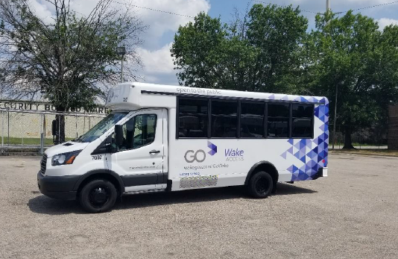
FY25 5311 Admin/Capital Funding Updates – Anita
Project | Total Amount | Local Share
5311 Administrative | $312,345 | $46,852
Combined Capital | $1,403,000 | $140,300
Total | $1,715,345 | $187,152
Combined Capital included funding for 10 vehicles and 10 wrapping services.

Slide 8
FY26 Vendor Contract Amendment
Vendor: RATP Dev USA, Inc.
Original Description of Services: To provide specialized transportation services for the General Public, Medicaid Beneficiaries, and Microtransit
Amended Billing and Revenue Structure:
The Parties agree to convert the monthly invoicing to a fully hourly rate. Cost Proposal combines the converted variable rate and monthly fixed cost (per Revenue hours billed). The Pass-Through Costs will be billed per the actual expenditure incurred and will be billed at any hourly rate (adjusts monthly per actual costs and revenue hours).
Cost increase amounts to $329,000 in annual fixed costs allocated per Revenue Hour for 4 additional positions. Positions include 1 Technician, 1 Utility employee, and Dispatchers/Schedulers. In addition, the annual cost of the Ecolane service of $184,463 will be amortized through the hourly Revenue hour rate.
RATP Dev shall submit an invoice to Wake County by the tenth day of each month following the invoiced month of service

Slide 9
FY26 Vendor Contract Amendment- Continued
Amended Billing and Revenue Structure:
For any pass-through expenses over $2,500, supporting documents that itemize and substantiate the expense must be submitted to GoWake Access for approval prior to the purchase.

Slide 10
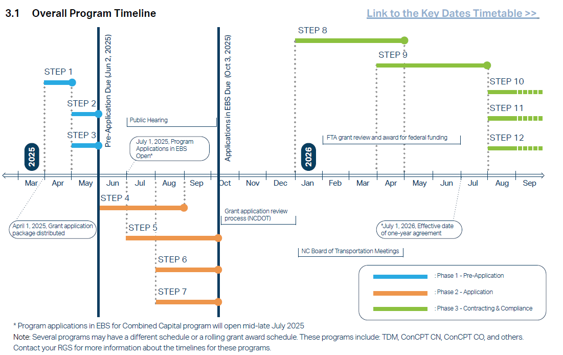
Unified Grant Application/Community Transportation Program FY27
The Unified Grant Application (UGA) is a set of grants awarded by NCDOT every year for operations, planning, and capital expenses for transit agencies.
GoWake Access receives funding under the Admin/Operation 5311 and Combined Capital grants through this program yearly.
Preapproval complete, preparing for TAB approval and subsequent BOC approval for October 3rd deadline.

Slide 11

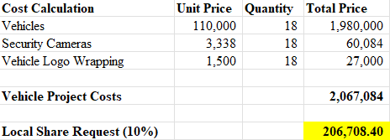
Unified Grant Application/Community Transportation Program FY27
Admin Request:
Salaries, fringe benefits, travel, marketing material, legal advertising, NCPTA dues
Capital Request
Vehicles, security cameras, wrapping services
GoWake Access will request NCDOT 5311 Admin and Combined Capital grant match funding through FY26 Wake Transit amendment request.
Request 1:
Admin total allocation and requested Wake Transit match
Request 2:
Capital total allocation and requested Wake Transit match

Slide 12
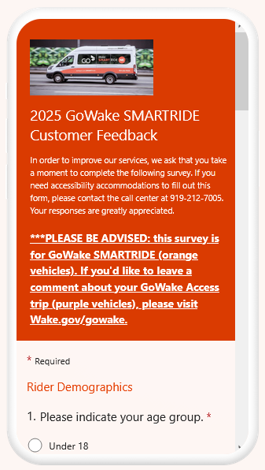
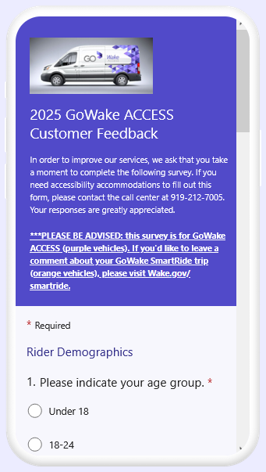
Community Engagement – Nikki Abija
GoWake Access and SmartRide surveys
Physical mail and online formats
Advertised on buses, website, and mass email
Received 22 mail-in surveys
4 Incomplete
SmartRide Responses Overview
33 responses
Most collected in ~15 days
GoWake Access Responses Overview
56 Responses
Most collected in ~30 days

Slide 13
Survey Results – Nikki Abija
Takeaways
Riders overall enjoy GoWake SmartRide and GoWake Access
They see value in the program
High satisfaction with drivers, call center reps, vehicles
Mass appeal across many demographics
Opportunities for improvement
Issues with the GoAccess! app
Ride availability
Riders have survey fatigue
Small sample size
Need to find more creative ways to engage

Slide 14
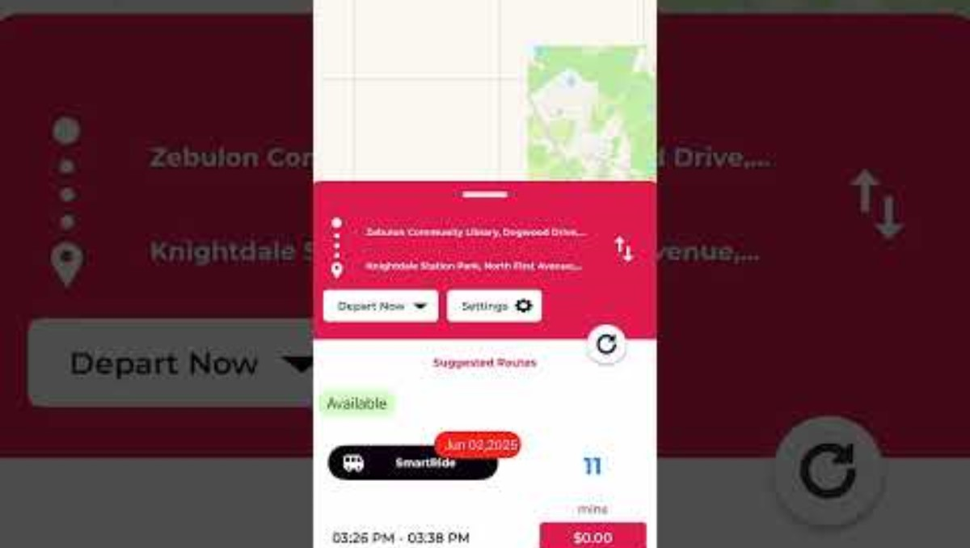
SmartRide – Tutorial Video Complete
Our communications team created a tutorial video to increase app usage

Slide 15
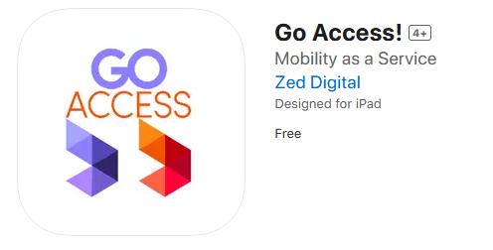
GoAccess! App/X4MaaS Amber and Paris
Launched July 1st, 2024

Slide 16
Reoccuring Business-Transit Reports
Vendor Report – Treascia Amedee
Trips Report, Statistics – Amber Scott
Financial Report – Gwendolyn Avery
Complaints Reports – Claudia Garay

Slide 17
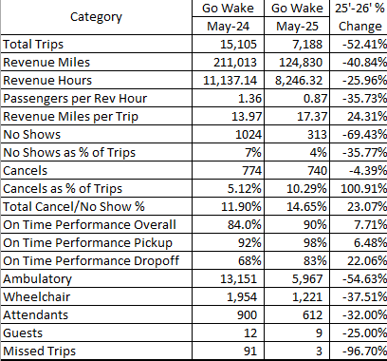
May GoWake Access Ridership
May

Slide 18
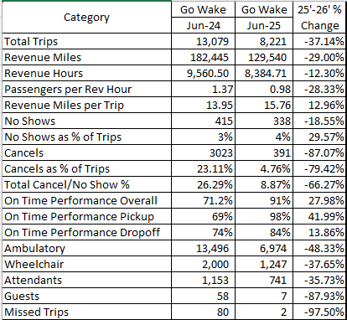
June GoWake Access Ridership
June

Slide 19
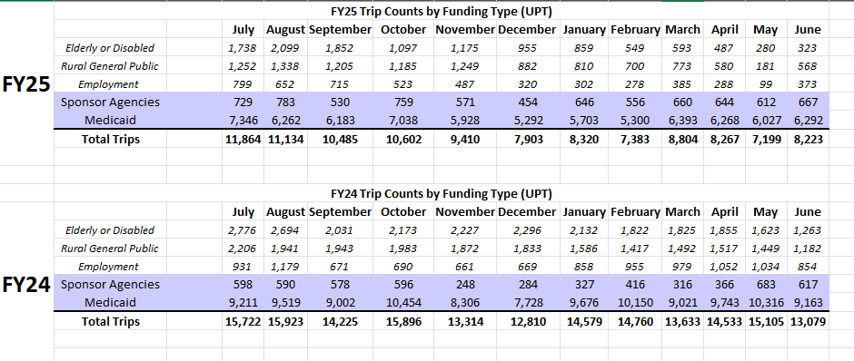
GoWake Access Trips
Notes:
Greet everyone.
May and June Trip Numbers.
35.42% decrease in trips from March FY24 to March FY25.
43.11% decrease in trips from April FY24 to April FY25.
Questions?

Slide 20
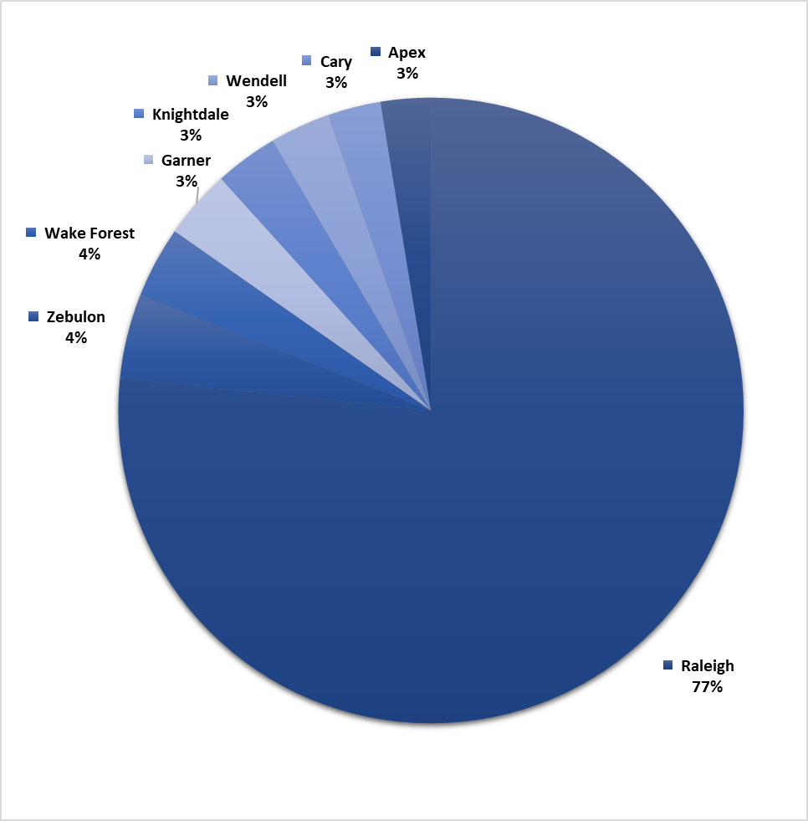
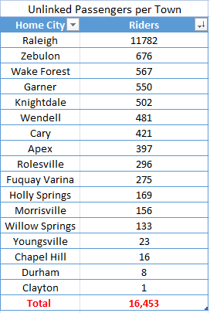
General Public Hometowns
Notes:
Top 10 of the total to display within Chart.
Questions?

Slide 21
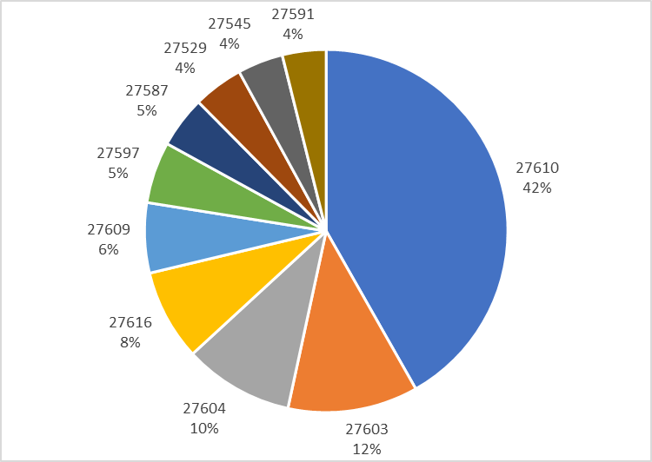
General Public Raleigh
Notes:
Top 10 of the total to display within Chart.

Slide 22
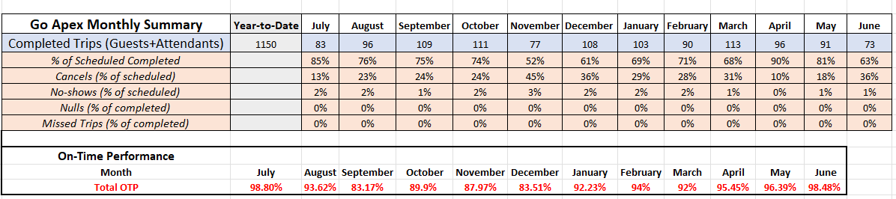
Go-Apex

Slide 23
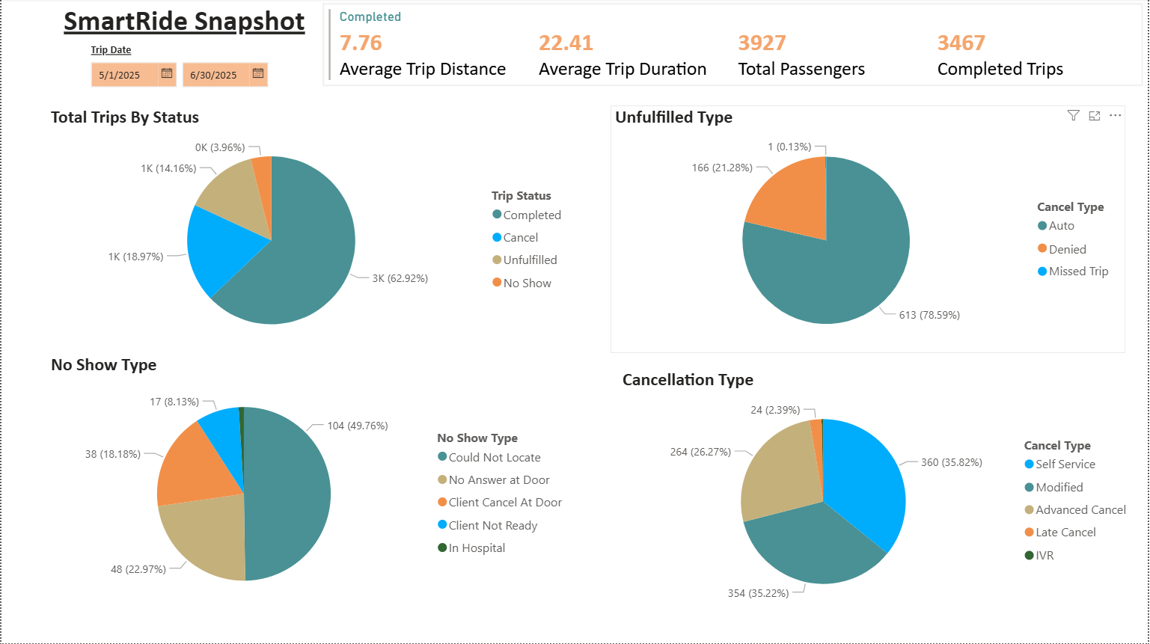
Microtransit NE- Summary

Slide 24
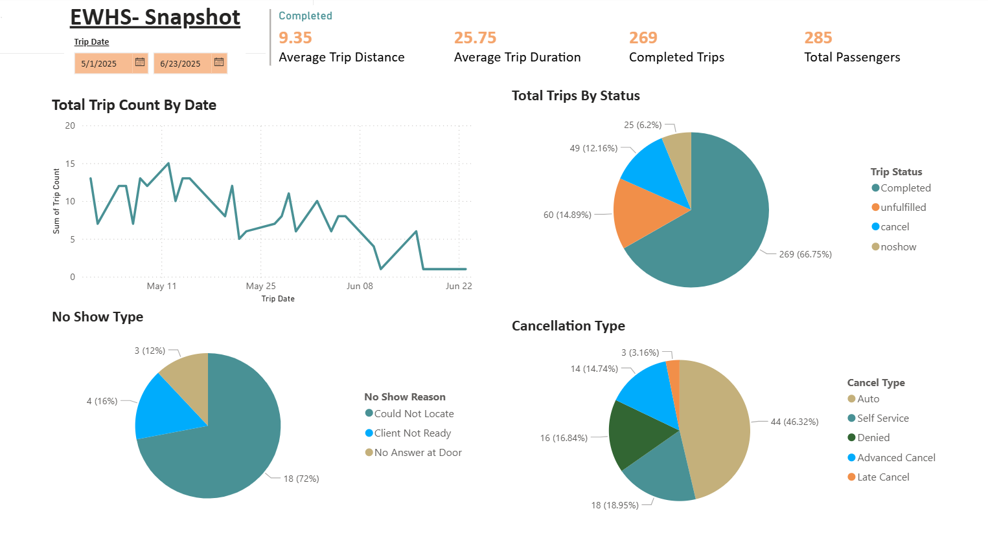
East Wake High School- Summary

Slide 25
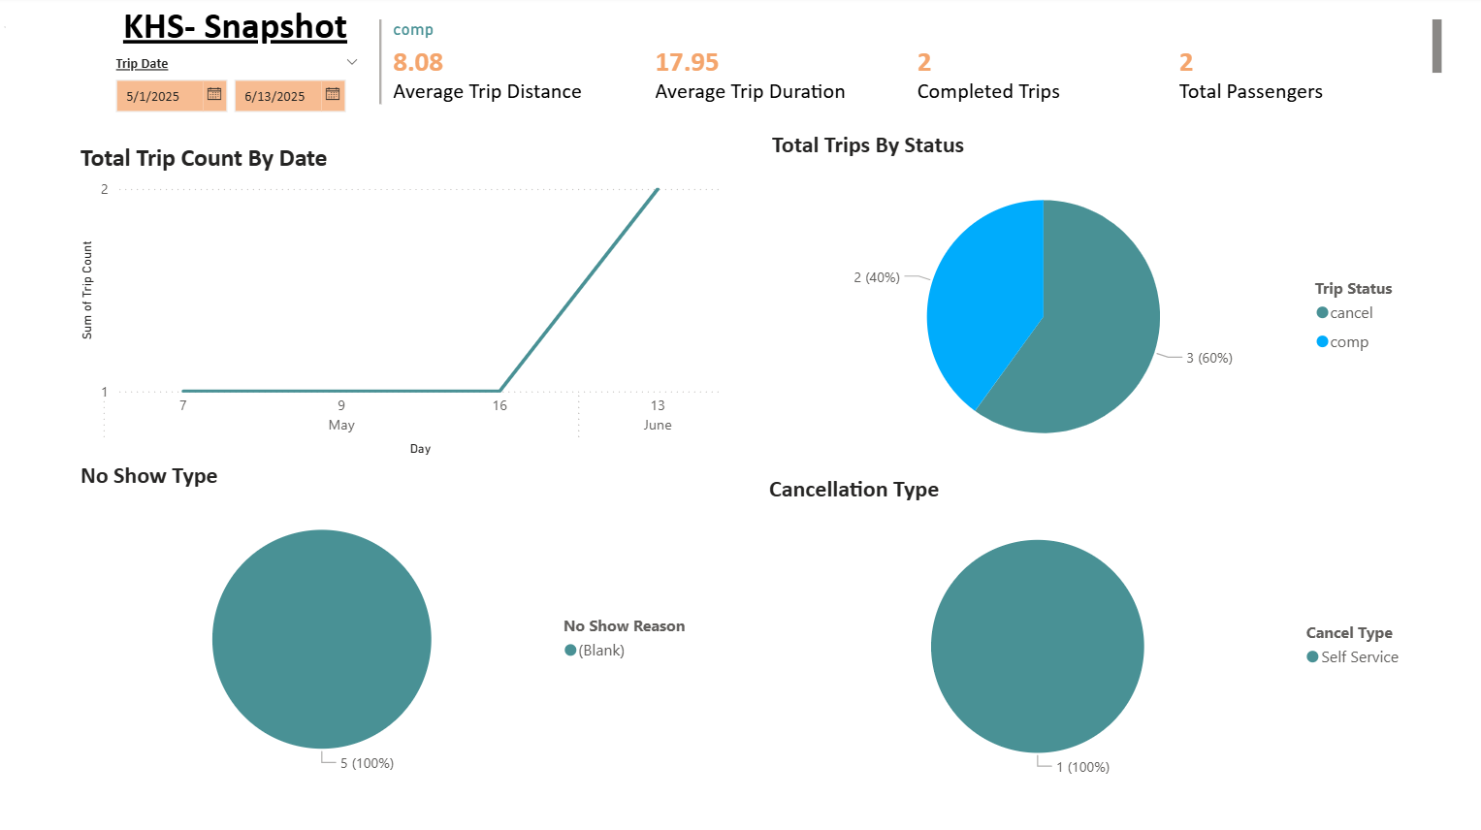
Knightdale High School- Summary

Slide 26
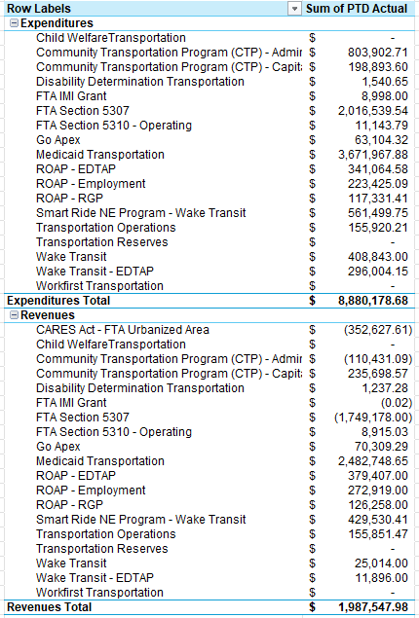
Financial Operations Report – FY2025

Slide 27

Financial Grant Report – FY2025

Slide 28
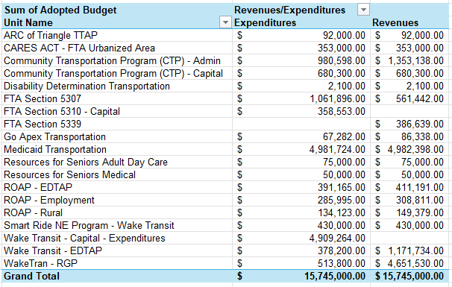
FY26 Multi-YR Budget

Slide 29



Customer Service Ticket Summary
Presented to
Wake County Transportation Program Manager Anita Davis
May FY-25
Intradepartmental data summary compiled by
the Voice of the Customer unit.
NOT FOR PUBLICATION

Slide 30

May Transportation Tickets “v” Total Rides
VOC tickets are for all trips performed for April. That is a 730% increase from May FY24 (30) to May FY25 (249).
Notes:
March total trips performed: 123 out of 8,804
April total trips performed: 204 out of 8,267
May total trips performed: 249 out of 7,199

Slide 31

Service Ticket Categories “v” Prior Months
Who was the complaint about?
Ticket | Total
Other | 229
Customer Service Rep. | 12
Driver | 6
Dispatcher | 4
Vendor Manager | 1
TOTAL | 252
From March to May
Notes:
Data: May 1-31, 2025.

Slide 32

May Service Ticket Sub-Category
May Top Five Categories
May Reasons For Calls | Number of Incidents
Appointment Phone Line | 14
Repeated Issues | 14
General Question | 5
Late | 4
Dispatcher Customer Service Issue | 3
Early | 1
No Show Dispute | 1
Total | 40
Late
Late
Repeat
Issues
Rider
No
Show
Late
General
Question
Repeat
Issues
General
Question
Vendor
No Show
Reg.
Followed
Careless
Driving
July
Late
Oct.
July
Late
May FY-25
Notes:
Top #1 Category for the month of May is Appointment Phone Line.

Slide 33

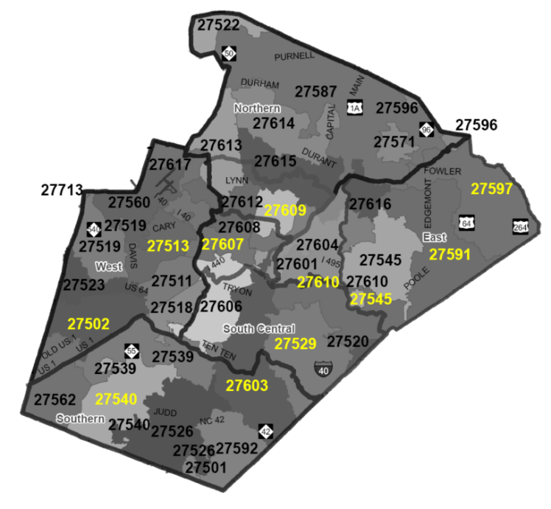
May Ride by Zip Code for Tickets
27610 | 16.06% | 27518 | 2.41% | 27617 | 0.80%
27603 | 13.65% | 27615 | 2.41% | 27513 | 0.40%
27604 | 9.64% | 27613 | 2.01% | 27526 | 0.40%
27609 | 9.24% | 27545 | 1.61% | 27591 | 0.40%
27601 | 8.03% | 27560 | 1.61% | 27614 | 0.40%
27607 | 6.02% | 27511 | 1.20% | 27703 | 0.40%
27606 | 4.82% | 27608 | 1.20% | 27705 | 0.40%
27616 | 4.42% | 27520 | 0.80%
27612 | 3.61% | 27577 | 0.80%
27529 | 2.81% | 27587 | 0.80%
27605 | 2.81% | 27597 | 0.80%
Area code 27610 has the
most reported tickets in May.
May FY-25
Notes:
Zip Code 27610 has the highest reported tickets for May FY25.

Slide 34
Questions?
May FY-25

Slide 35
Good of the Order Announcements

Slide 36
Adjourn

