Slide 1
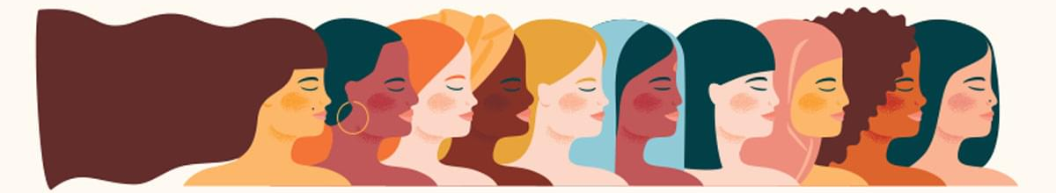
Women’s History Month
Notes:
Women’s History Month

Slide 2
March is Women’s History Month
About Women's History Month
Women’s History Month began as a local celebration in Santa Rosa, California in 1978. Organizers selected the week of March 8 to correspond with International Women’s Day
In 1980, a consortium of women’s groups and historians - led by the National Women’s History Project - successfully lobbied for national recognition
In February 1980, President Jimmy Carter issued the first Presidential Proclamation declaring the Week of March 8th 1980 as National Women’s History Week
Since 1995, presidents have issued a series of annual proclamations designating the month of March as Women’s History Month
Source: https://www.womenshistory.org/womens-history/womens-history-month
Notes:
March is Women’s History Month
History Month began as a local celebration in Santa Rosa, California in 1978. The Education Task Force of the Sonoma County (California) Commission on the Status of Women planned and executed a “Women’s History Week” celebration in 1978. It was this year that The Education Task Force of the Sonoma County (California) Commission on the Status of Women planned and executed a “Women’s History Week” celebration.
Organizers selected the week of March 8 to correspond with International Women’s Day. The movement spread across the country as other communities initiated their own Women’s History Week celebrations the following year. The movement spread across the country as other communities initiated their own Women’s History Week celebrations the following year.
In 1980, a consortium of women’s groups and historians—led by the National Women’s History Project (now the National Women's History Alliance)—successfully lobbied for national recognition.
In February 1980, President Jimmy Carter issued the first Presidential Proclamation declaring the Week of March 8th 1980 as National Women’s History Week.
Since 1995, presidents have issued a series of annual proclamations designating the month of March as “Women’s History Month.” These proclamations celebrate the contributions women have made to the United States and recognize the specific achievements women have made over the course of American history in a variety of fields.

Slide 3

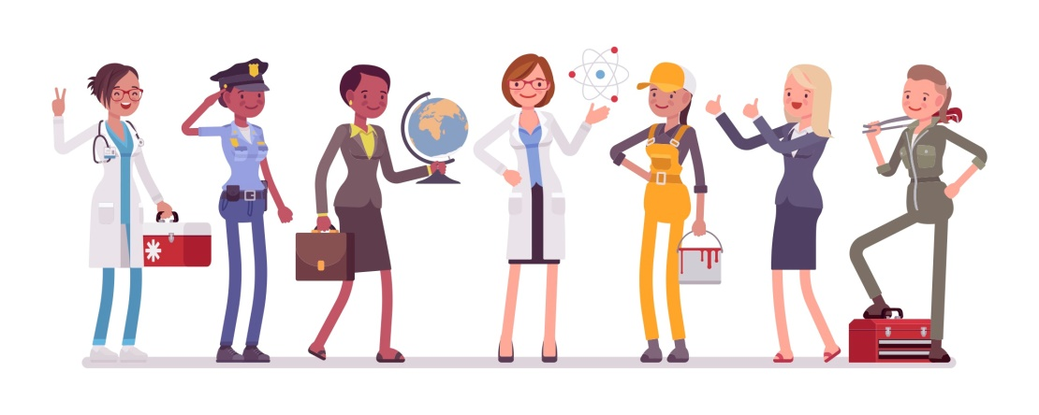

Women’s History Month
In 2019, there were well over 76 million women aged 16 and over in the labor force, representing close to half of the total labor force
As of 2019, Women comprised 50.2% of the college-educated labor force, up from 45.1% in 2000
Currently, 21 women sit as the head of state or government in 193 countries around the world
Notes:
In 2019, there were well over 76 million women aged 16 and over in the labor force, representing close to half (47.0%) of the total labor force
As of 2019, Women comprised 50.2% of the college-educated labor force, up from 45.1% in 2000
Currently, 21 women sit as the head of state or government in 193 countries around the world, according to the Council on Foreign Relations (CFR), a US-based think-tank

Slide 4
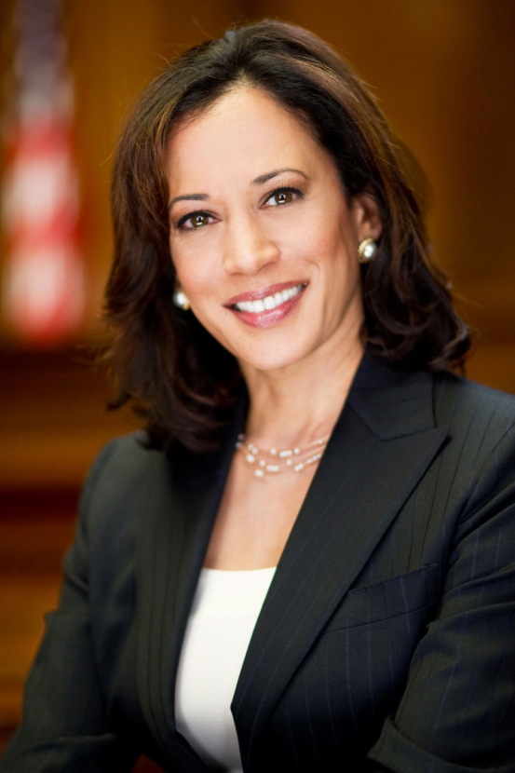
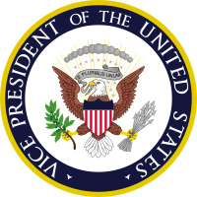
Women’s History Month
Kamala D. Harris
First Female Vice President of the
United States of America
  VP Harris was born in Oakland, CA
  Served as the AG of CA from 2011-2017
  Served as US Senator from 2017-2021
Notes:
Kamala D. Harris - First Female Vice President of the United States of America (“that deserves a round of applause I would say”)
Vice President Harris was born in Oakland, CA and served as the Attorney General of California from 2011-2017 and as a US Senator representing California from 2017-2021

Slide 5
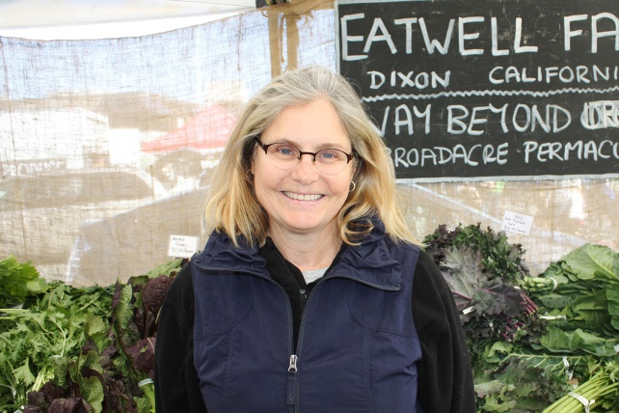
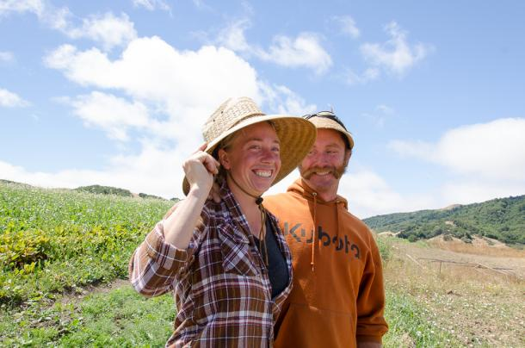
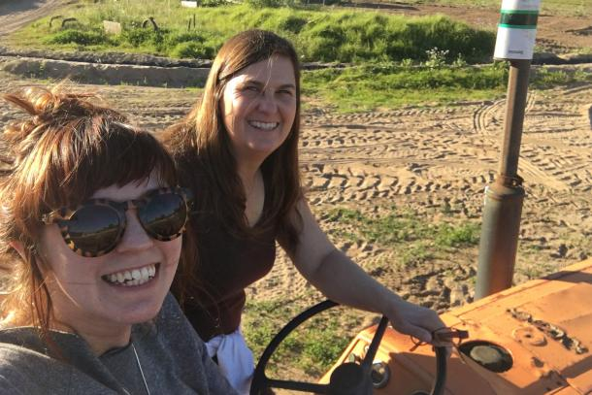
Women in Agriculture
According to the USDA Census of Agriculture, nearly 30% of American farms are principally operated by women.
President Biden nominated Dr. Jewel Bronaugh to serve as the U.S. Deputy Secretary of Agriculture. If confirmed, she would be the first African American woman to serve in the position.
Women currently head state departments of agriculture in 13 states.
15 women in California serve as county agricultural commissioners.
Notes:
Women in CA Ag Leadership
Karen Ross - is the current the Secretary of the California Department of Food and Agriculture (since 2011)
Ann Veneman California’s first female Secretary of Agriculture (1995-1999) AND the first (and only) female that served as US Secretary of Agriculture (2001-2005)
Becky Bailey-Findley Served as the first female CEO for the OC Fair & Event Center from 1994-2008

Slide 6
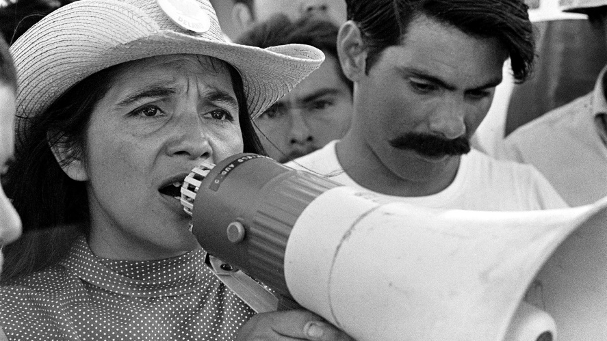
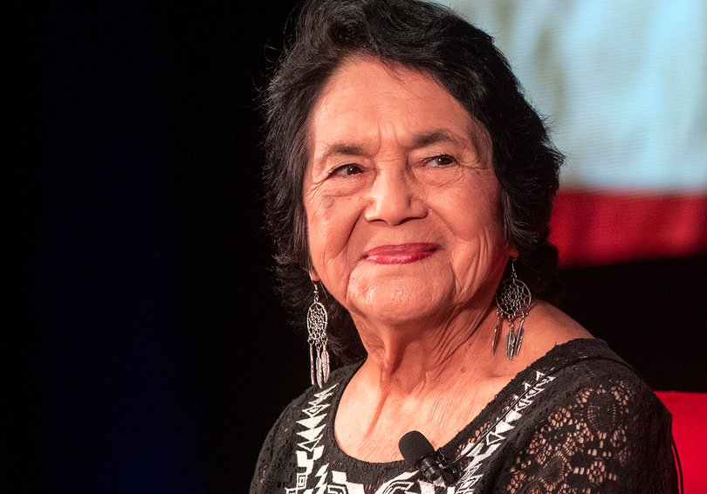
Women in Agriculture
Dolores Huerta
American labor leader and civil rights activist
Co-founder (along with Cesar Chavez) of the national Farmworkers Association, which later became the United Farm Workers (UFW)
Helped organize the Delano Grape Strike in 1965 in CA and was the lead negotiator in the workers’ contract that was created after the strike
Notes:
Women in CA Ag Leadership
Karen Ross - is the current the Secretary of the California Department of Food and Agriculture (since 2011)
Ann Veneman California’s first female Secretary of Agriculture (1995-1999) AND the first (and only) female that served as US Secretary of Agriculture (2001-2005)
Becky Bailey-Findley Served as the first female CEO for the OC Fair & Event Center from 1994-2008

Slide 7
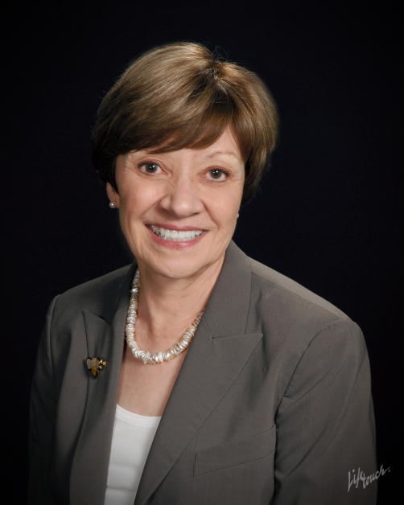
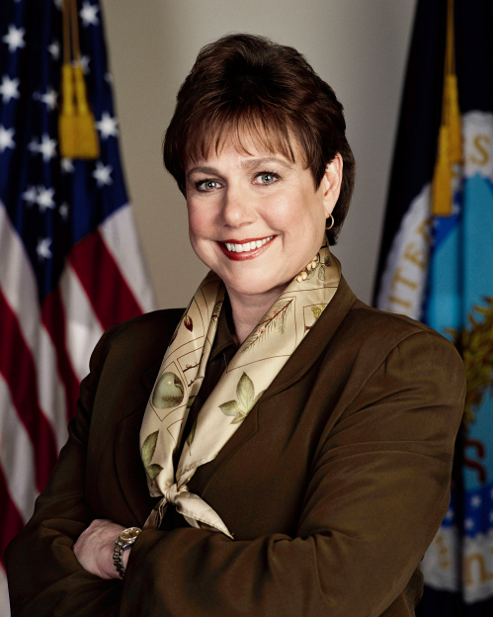
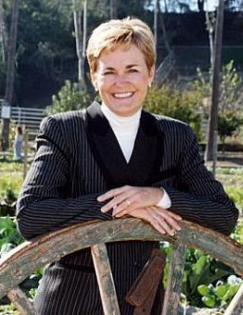
Women in CA Ag Leadership
Karen Ross
Secretary of the
California Department of Food and Agriculture
Ann Veneman
California’s first female Secretary of Agriculture AND the first (and only) female to serve as
US Secretary of Agriculture
Becky Bailey-Findley
Served as the first female CEO for the
OC Fair & Event Center
Notes:
Women in CA Ag Leadership
Karen Ross - is the current the Secretary of the California Department of Food and Agriculture (since 2011)
Ann Veneman California’s first female Secretary of Agriculture (1995-1999) AND the first (and only) female that served as US Secretary of Agriculture (2001-2005)
Becky Bailey-Findley Served as the first female CEO for the OC Fair & Event Center from 1994-2008

Slide 8
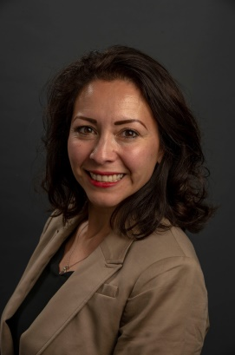
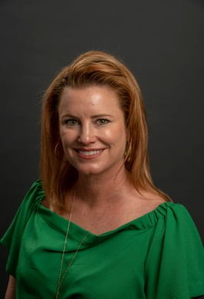
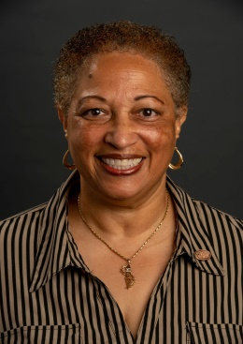
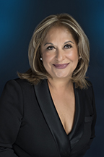
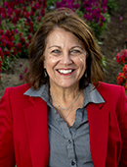
Women in CA Ag Leadership
50% of CDFA’s staff is female
Nearly half of all FFA members are women, and females hold approximately 50% of state leadership positions
Of the 76 California Fairs, 40% are led by female CEO/General Managers
In OC 70% of the Ag Teachers for Future Farmers of America (FFA Programs) are women
4 out of 8 (50%) of OC Fair Board Members are female
48% of OCFEC’s Civil Service staff are female. 50% are in management positions, including Michele Richards, current CEO
Natalie Rubalcava-Garcia
Board Chair
Member since 2018
Ashleigh Aitken
Member since 2012
Barbara Bagneris
Member since 2014
Sandra Cervantes
Member since 2014
Michele Richards
OC Fair & Event Center CEO
Notes:
50% of California Department of Food & Agriculture’s staff is female
15 women in California serve as county agricultural commissioners
According to the National FFA Organization, “Nearly half of all FFA members are women, and females hold approximately 50 percent of state leadership positions.”
Of the 76 California Fair's listed CDFA’s website, 40% (31) are led by female CEO/General Managers
In Orange County 70% of the Agriculture Teachers for Future Farmers of America (FFA Programs) are women
4 out of 8 (50%) of OC Fair Board Members are female
48% of OC Fair & Event Center’s Civil Service staff are female, with 50% in management positions, including Michele Richards, current CEO.

Slide 9
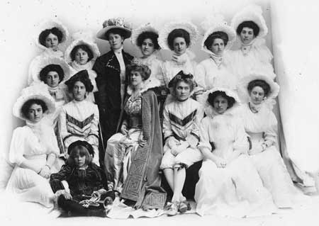
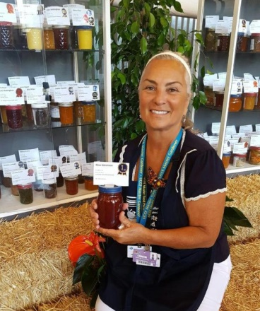
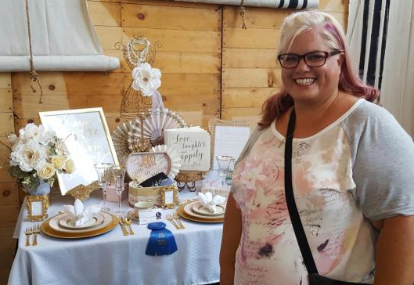
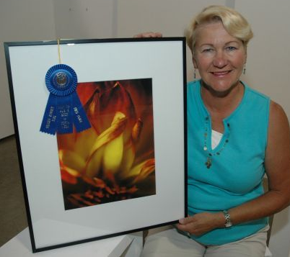
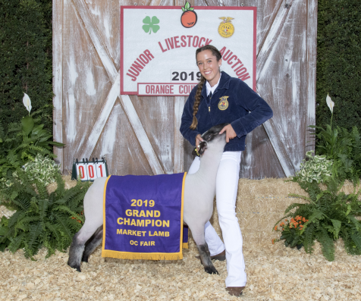
Women at the OC Fair
By the early 1900’s in an effort to promote participation by Women, domestic entries offering premiums (cash prizes) and the presentation of an annual ball were introduced
In 1907, the very first carnival queen, Ms. Ethel Chapman, was
crowned. The tradition of having a fair queen became an annual
event until 1983
In a guest survey conducted at the OC Fair in 2019, attendee profile
was 59% female
In 2019, approximately 59% of all adult exhibitors were female
Notes:
Women at the OC Fair
By the early 1900’s in an effort to promote participation by Women domestic entries offering premiums (cash prizes) and the presentation of an annual ball were introduced
In 1907, the very first carnival queen, Ms. Ethel Chapman, daughter
of C.C. Chapman, the “Valencia Orange King,” was crowned. The
tradition of having a fair queen became an annual event until 1983
In a guest survey conducted at the OC Fair in 2019, attendee profile was 59% female
In 2019, approximately 59% of all adult exhibitors were female

Slide 10
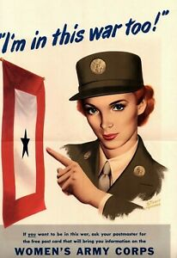
Women in OC Military History
Approx. 350,000 American women joined the military during World War II
During the war, OC Fairgrounds was the site of SAAAB, a preflight training center for pilots, navigators & bombardiers
A unit of the Women’s Army Corps, WAC, was assigned to the SAAAB. WAC troops performed a variety of jobs such as nurses, mechanics, truck drivers, clerical staff & more
There commanding officer was Capt. Elizabeth A. Yancey.
Notes:
Women in OC Military History
Approximately 350,000 American women joined the military during World War II
During the war, the OC Fair was the site of SAAAB, a preflight training center for pilots, navigators and bombardiers
A unit of the Women’s Army Corps, WAC, was assigned to the SAAAB. WAC troops performed a variety of jobs such as nurses, mechanics, truck drivers, clerical staff & more

Slide 11
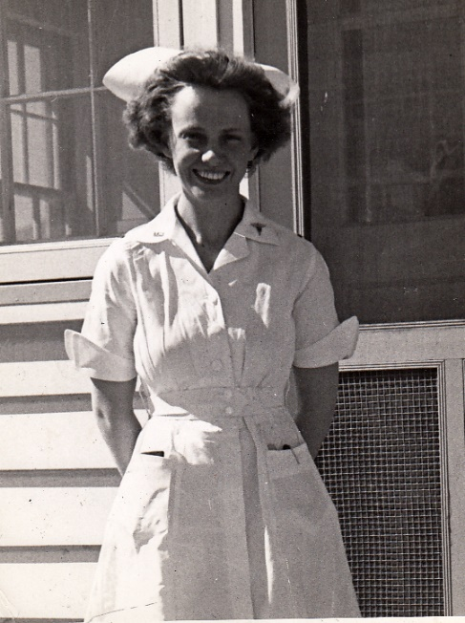
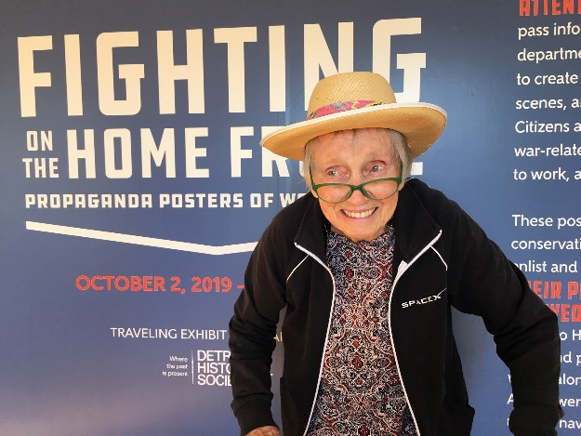
Women in OC Military History
Women who served in the Army Nurse Corps played a critical role in caring for injured troops during World War II. They often served in combat zones and tended to the injured during air transport
One such flight nurse, Jane Weller from Huntington Beach, served in the South Pacific during WWII. She hopped from island to island caring for General MacArthur’s troops
Notes:
Women who served in the Army Nurse Corps played a critical role in caring for injured troops during World War II. They often served in combat zones and tended to the injured during air transport
One such flight nurse, Jane Weller from Huntington Beach, served in the South Pacific during WW II. She hopped from island to island caring for General MacArthur’s troops

Slide 12
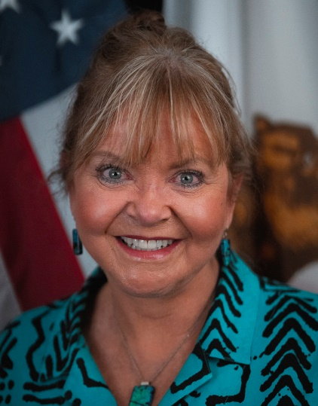
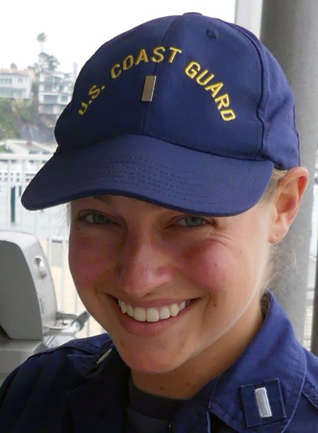
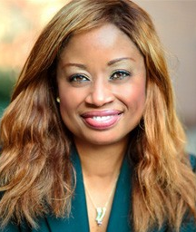
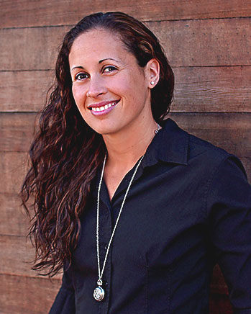
Military Women from OC
Brigadier General Robin Umberg, US Army, California State Veterans Board
Lt. Caroline Miller, US Coast Guard, Commander, US Coast Guard Cutter Narwhal
Jacqueline Eubany,
MD, US Navy Heart Surgeon
Andrea Marr, US Navy Veteran, Mayor Pro Tem for Costa Mesa City
Notes:
Military Women from OC
Brigadier General Robin Umberg, US Army, California State Veterans Board
Lt. Caroline Miller, US Coast Guard, Commander, US Coast Guard Cutter Narwhal
Jacqueline Eubany, MD, US Navy Heart Surgeon
Andrea Marr, US Navy Veteran, Mayor ProTem, City of Costa Mesa

Slide 13
How can you celebrate Women’s History Month?
Explore the history of women’s rights
Be aware of issues women still face today
Post on social media to spread awareness of Women’s History Month
Mentor a girl or fellow woman
Support a women’s nonprofit
Support women-owned businesses
Notes:
How can you celebrate Women’s History Month?
Explore the history of women’s rights
Be aware of issues women still face today
Post on social media to spread awareness of Women’s History Month
Mentor a girl or fellow woman
Support a women’s nonprofit
Support women-owned businesses

