Slide 1
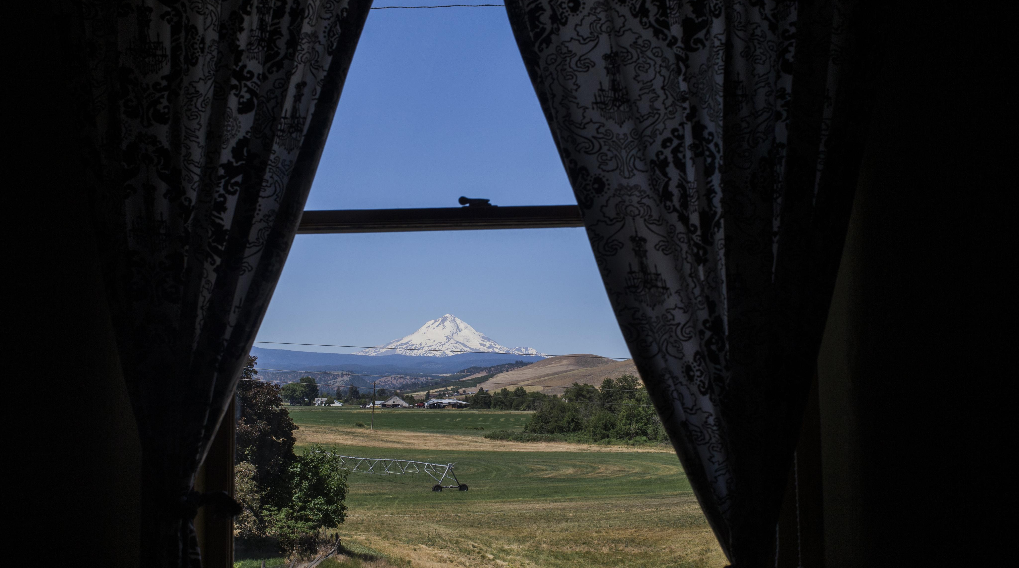
2.01.25
STATEWIDE LODGING SUMMARY REPORT
2024
Balch Hotel, Dufur OR
Photo Courtesy of Michael Hanson

Slide 2

INTRODUCTION
This report assesses lodging performance for the state of Oregon and its seven regions for calendar year 2024.
Hotel data is provided by CoStar/STR and vacation rental data is provided by AirDNA.
Please note that the data points in this report are preliminary figures. Both lodging vendors continue to update historical data over time to maintain and improve data accuracy. This is why historical figures might look different than previous report outs. If you have any questions about this please reach out to our team.
Hannah Hicks: hannahh@traveloregon.com
Javier Parada Torres: javierpt@traveloregon.com
Balch Hotel, Dufur OR
Photo Courtesy of Michael Hanson
Bowline Hotel, Astoria OR

Slide 3
KEY INSIGHTS
2024 Oregon lodging performance showed a marked improvement over 2023 figures. Year over year growth was positive for both hotel and vacation rentals.
For hotel performance, occupancy was the only metric that lagged behind 2023 levels.
When comparing 2024 hotel performance to 2019, Portland is the only region not to have recovered to pre-COVID revenue levels.
Vacation rental performance in 2024 outpaced both 2023 and 2019 levels for all metrics, statewide.
Portland is the only region that has not recovered to 2019 levels of vacation rental supply and demand.
Balch Hotel, Dufur OR
Photo Courtesy of Michael Hanson
Bowline Hotel, Astoria OR

Slide 4
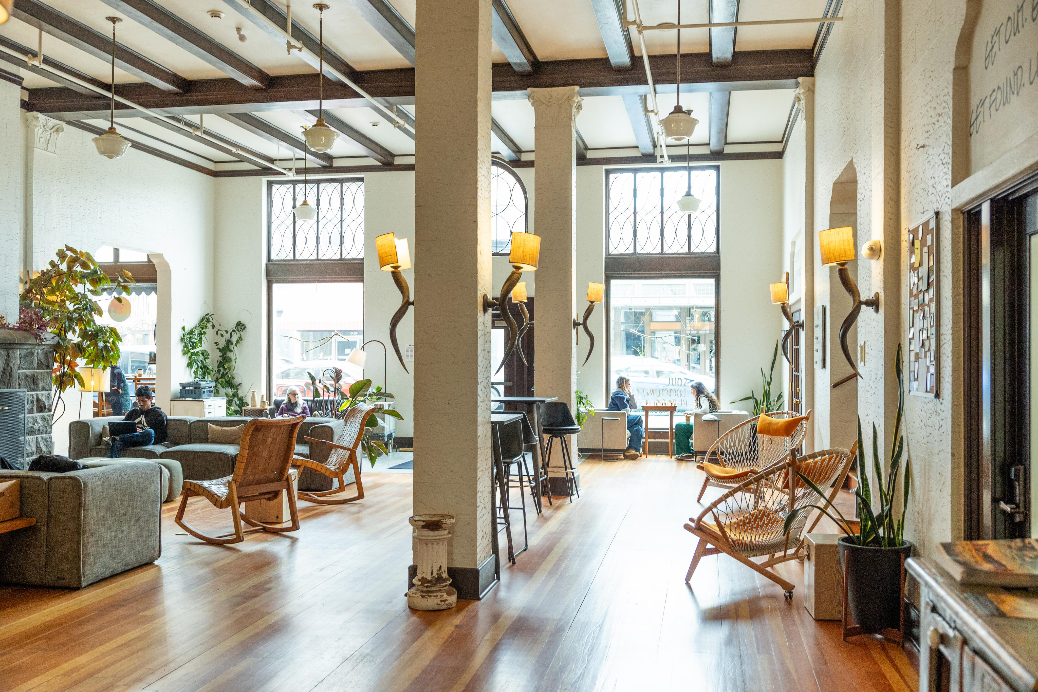
HOTEL PERFORMANCE
2024
SCP Hotel, Redmond OR
Photo courtesy of Travel Oregon

Slide 5
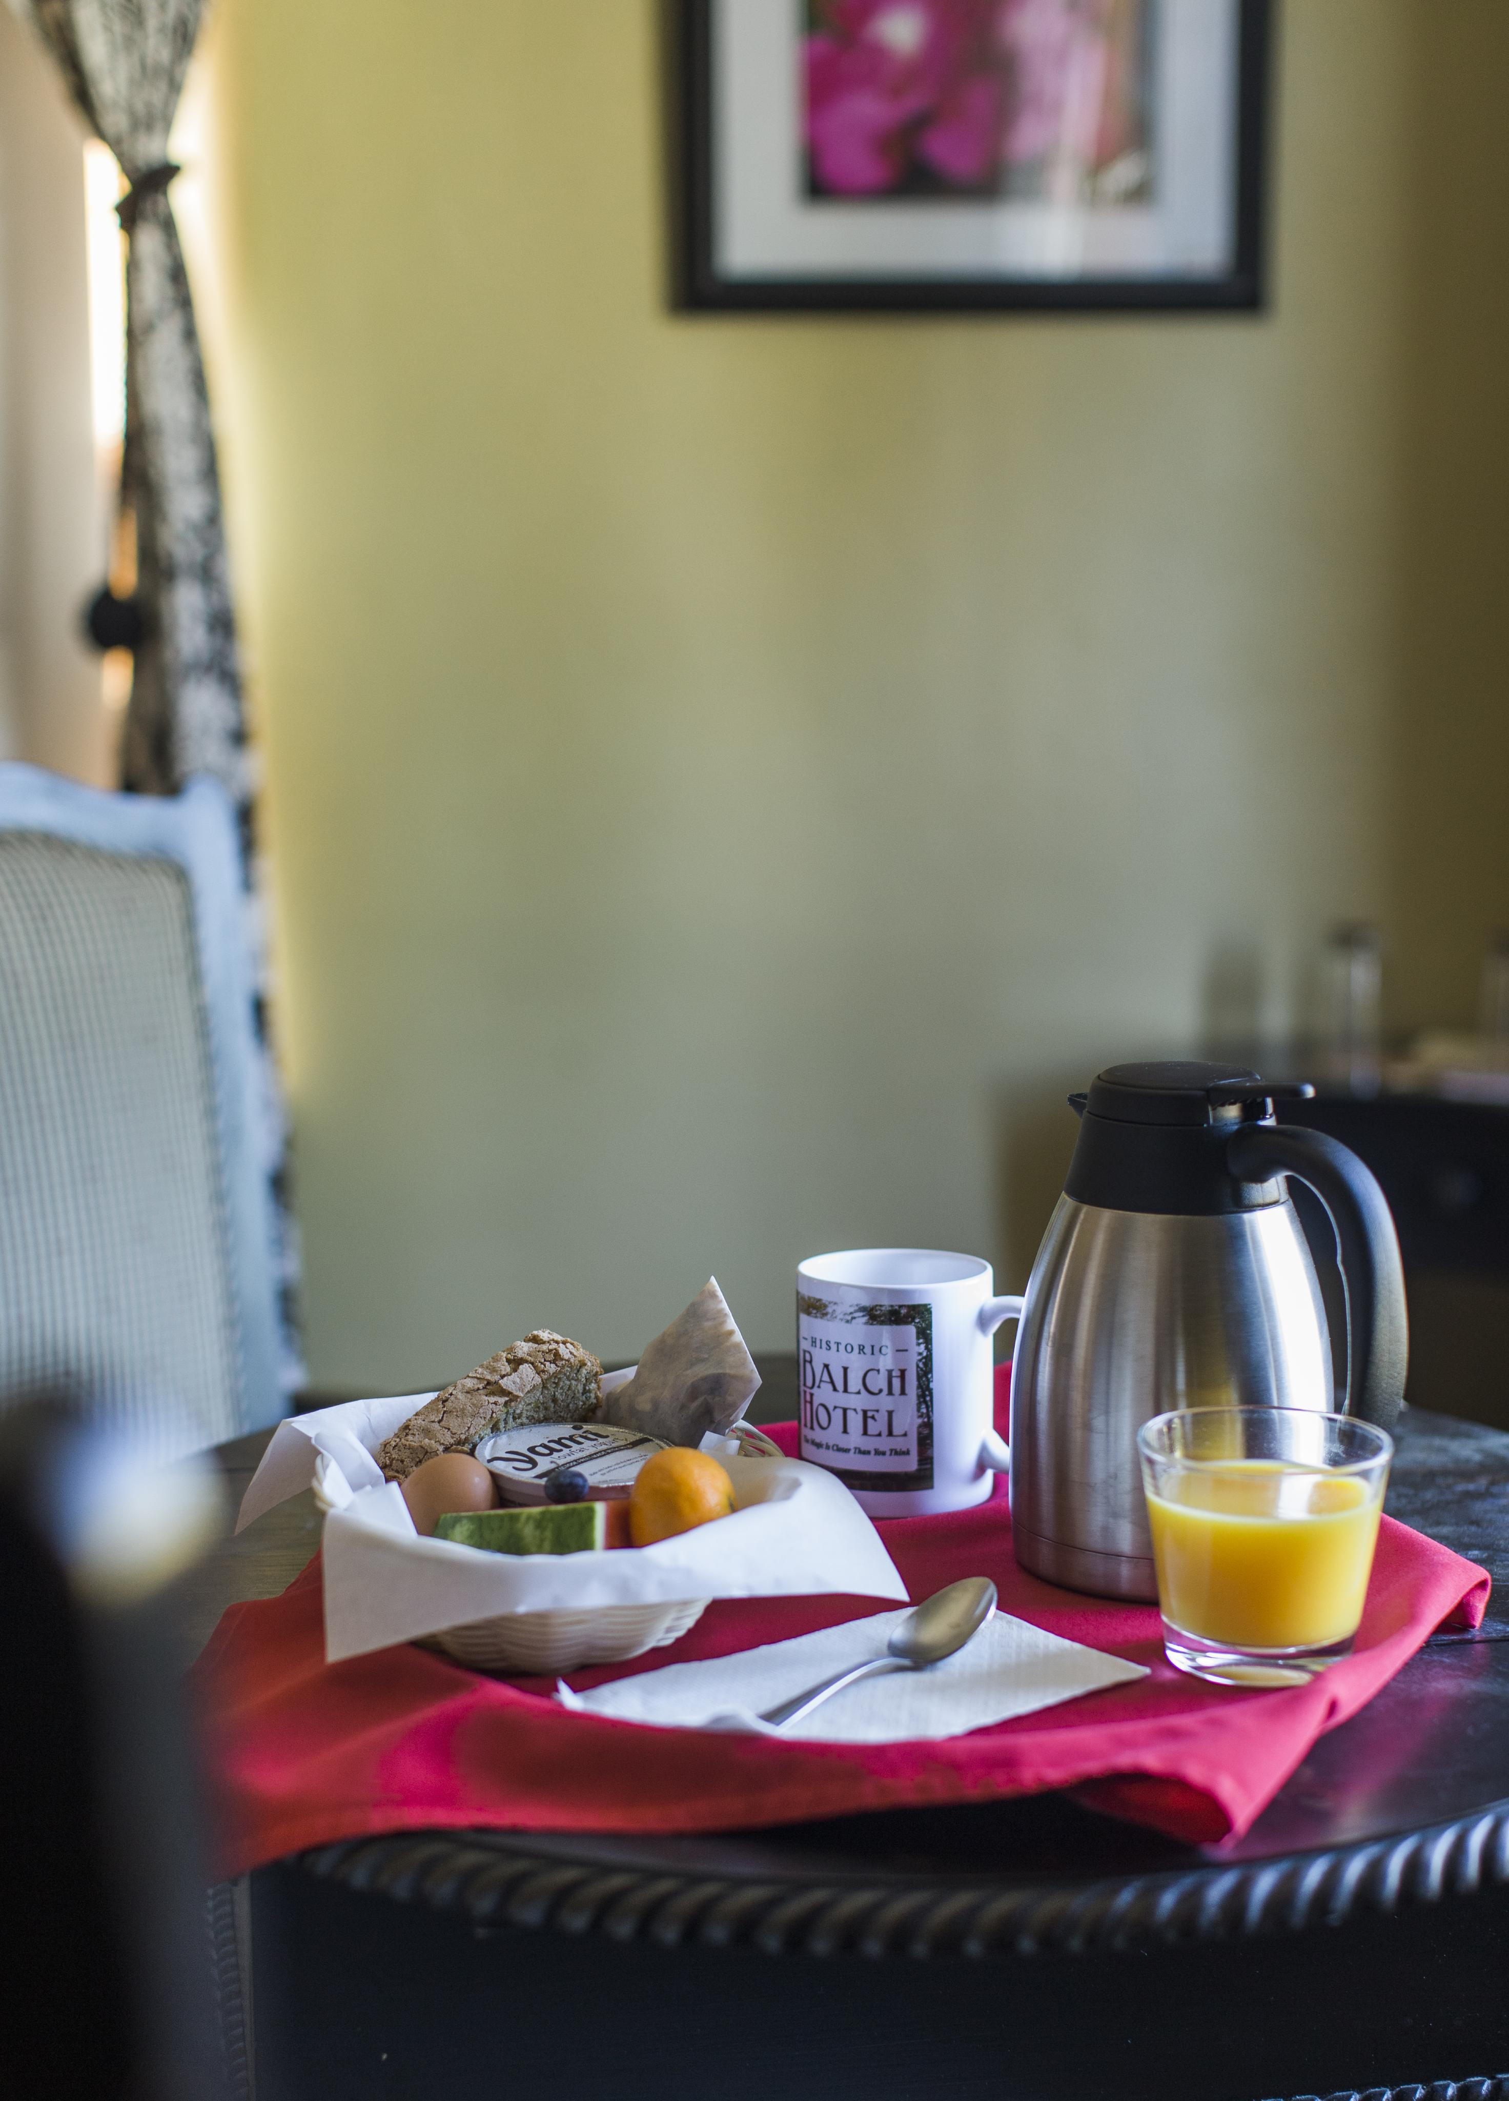
HOTEL PERFORMANCE
YEAR OVER YEAR(YOY)
STATEWIDE HIGHLIGHTS
Compared to 2023…
Occupancy in 2024 was up 1.6%
Room Revenue in 2024 was up 2.0%
Room Supply in 2024 was up 0.1%
Room Demand in 2024 was up 1.7%
Average Dormitory Rate (ADR) in 2024 was up 0.3%
Revenue Per Available Room (RevPAR) in 2024 was up 1.9%
Balch Hotel, Dufur OR
Photo Courtesy of Michael Hanson

Slide 6
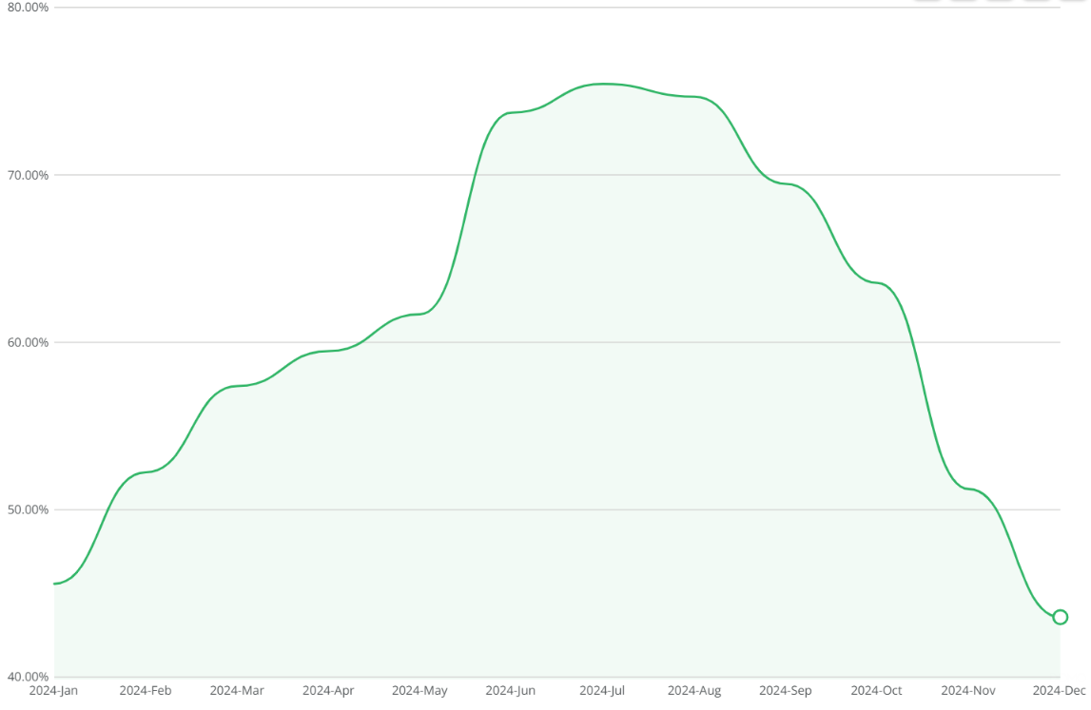
STATEWIDE OCCUPANCY
2024 AVERAGE: 60.7%
SOURCE: CoStar Group

Slide 7
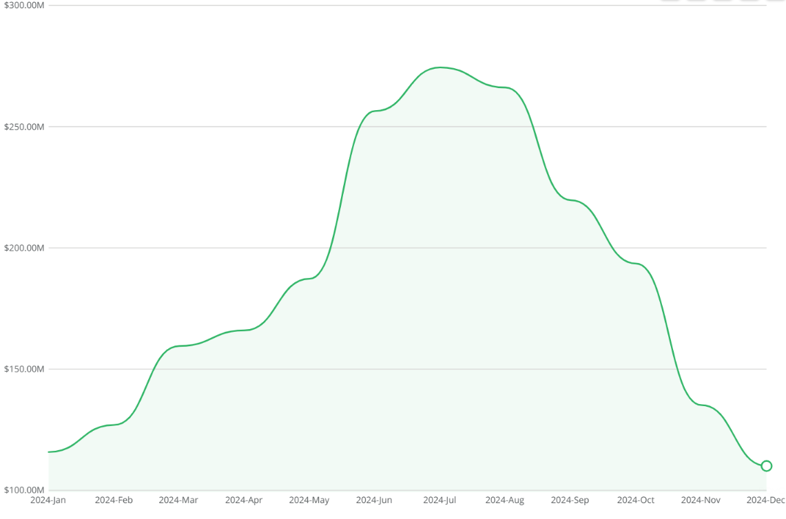
STATEWIDE REVENUE
2024 TOTAL: $2.2B
SOURCE: CoStar Group

Slide 8
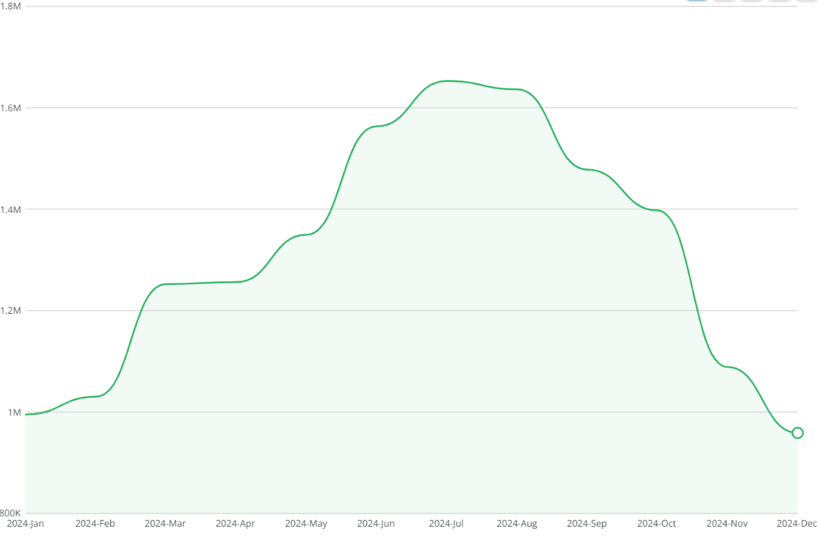
STATEWIDE ROOM DEMAND
2024 TOTAL: 15.7M BOOKED NIGHTS
SOURCE: CoStar Group

Slide 9
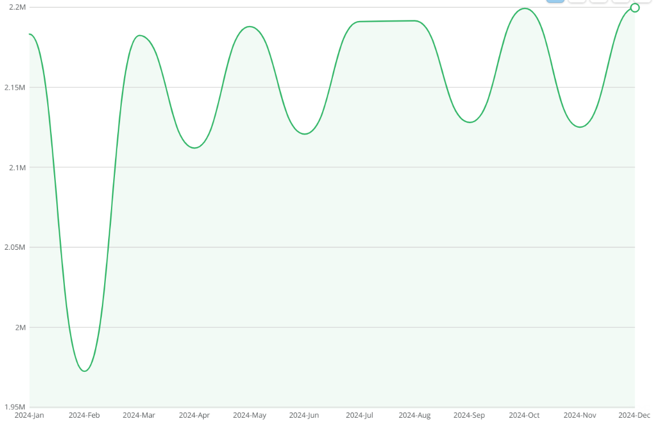
STATEWIDE ROOM SUPPLY
2024 TOTAL: 25.8M NIGHTS
*Please note: Room supply is a function of room inventory and nights in the month, the supply drop in February corresponds to it being a shorter month.
SOURCE: CoStar Group

Slide 10
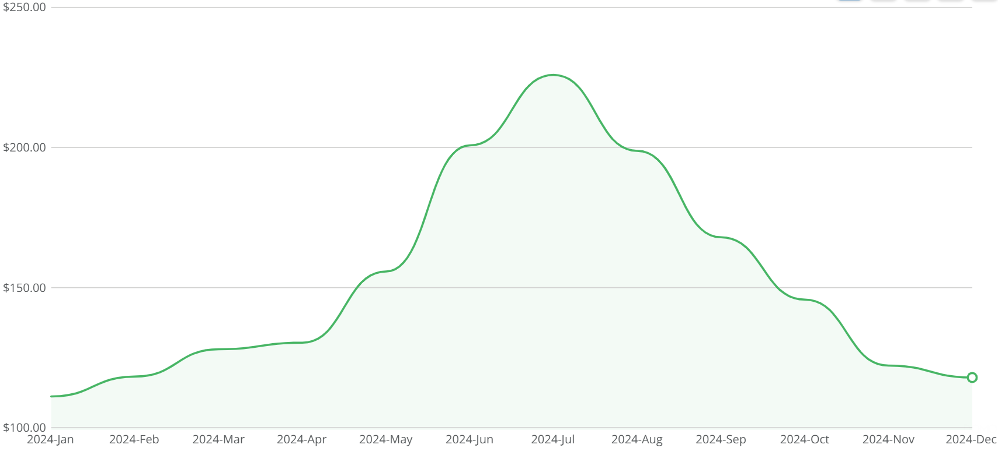
STATEWIDE ADR
2024 AVERAGE: $159.45
SOURCE: CoStar Group

Slide 11
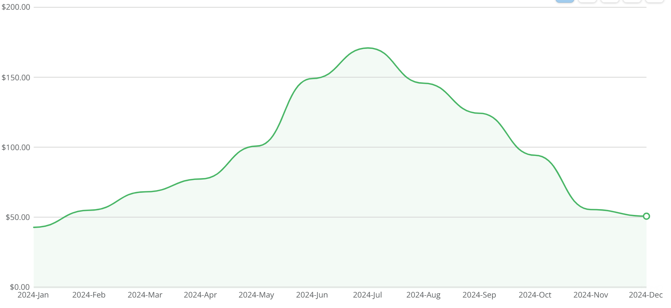
STATEWIDE REVPAR
2024 AVERAGE: $94.73 YTD
SOURCE: CoStar Group

Slide 12
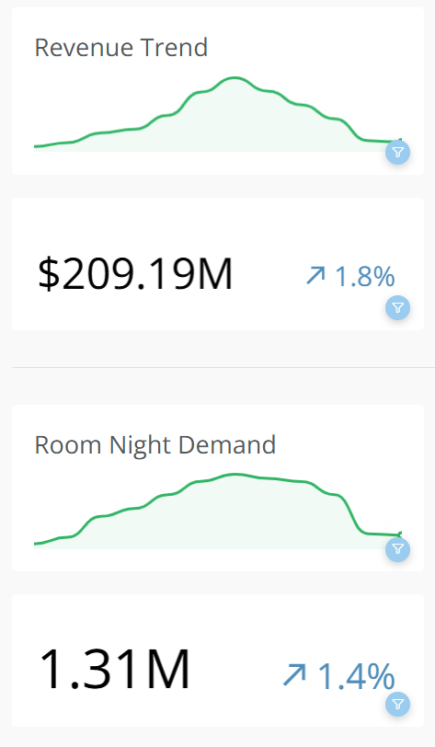
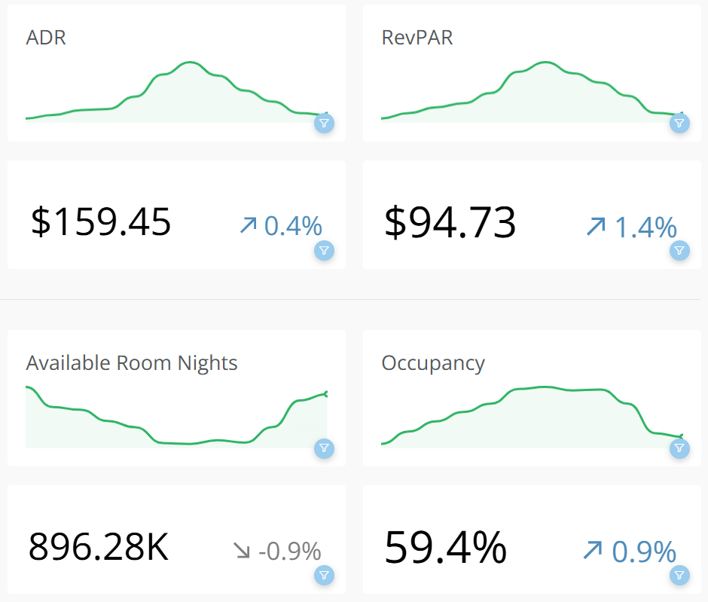
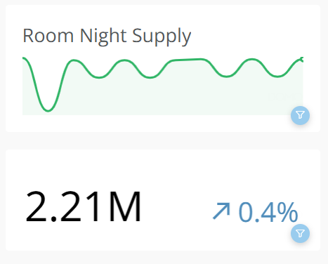
CENTRAL REGION
YEAR TO DATE PERFORMANCE 2024 COMPARED TO 2023
SOURCE: CoStar Group

Slide 13
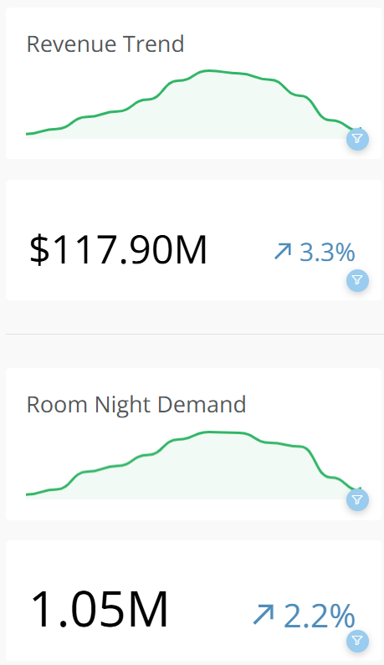
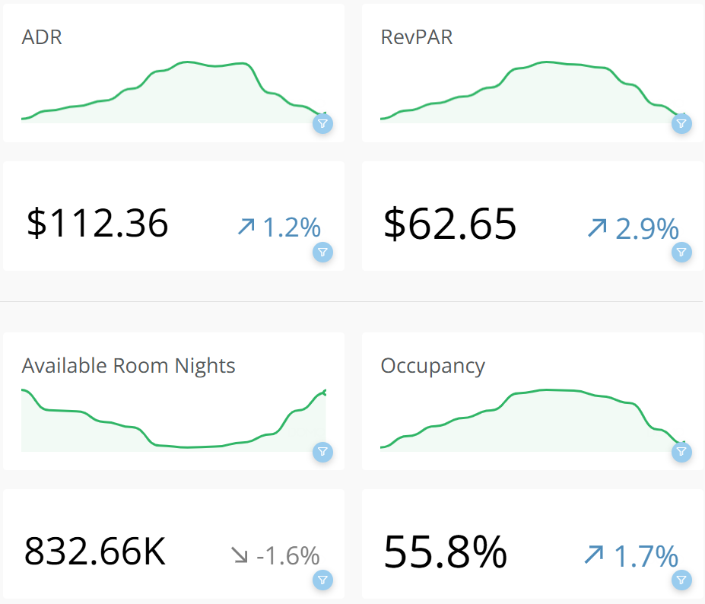
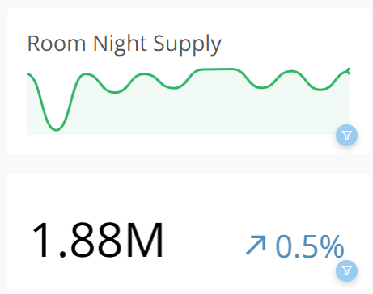
EASTERN REGION
YEAR TO DATE PERFORMANCE 2024 COMPARED TO 2023
SOURCE: CoStar Group

Slide 14
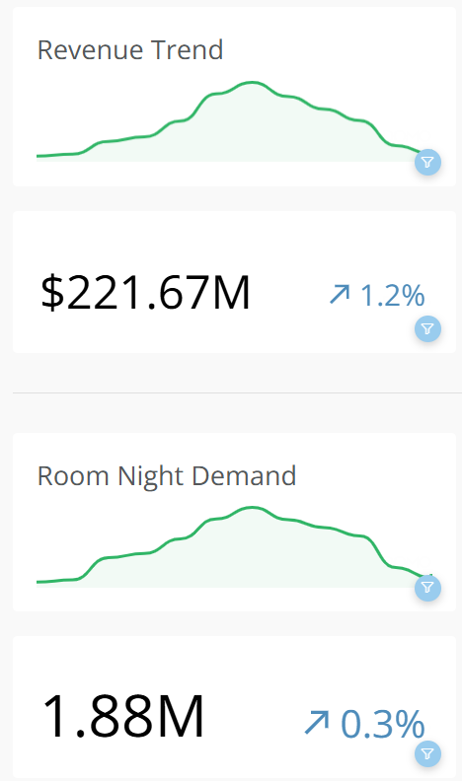
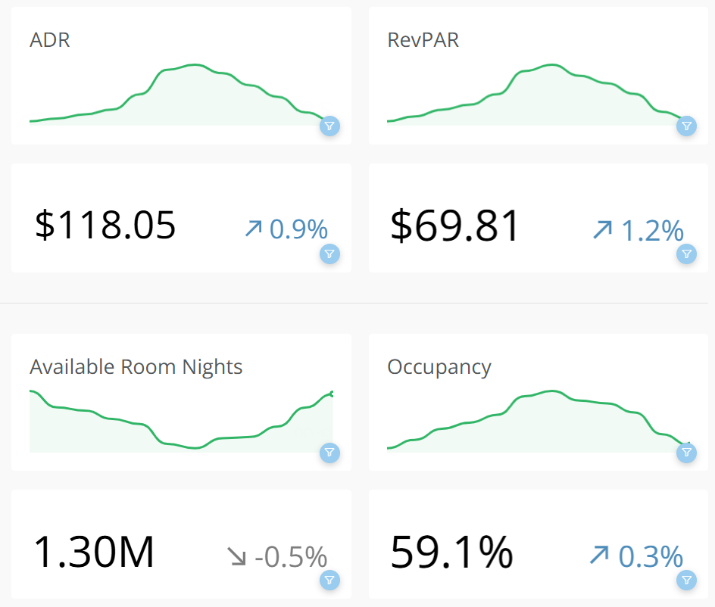
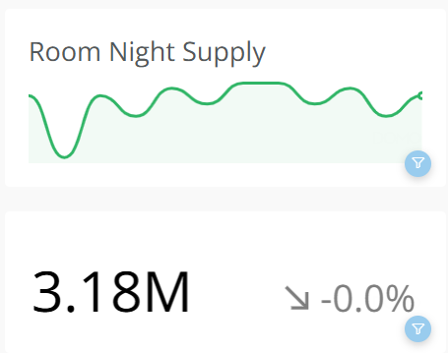
SOUTHERN REGION
YEAR TO DATE PERFORMANCE 2024 COMPARED TO 2023
SOURCE: CoStar Group

Slide 15
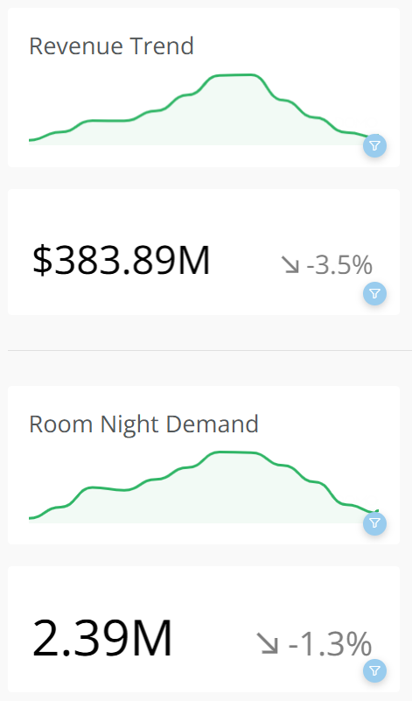
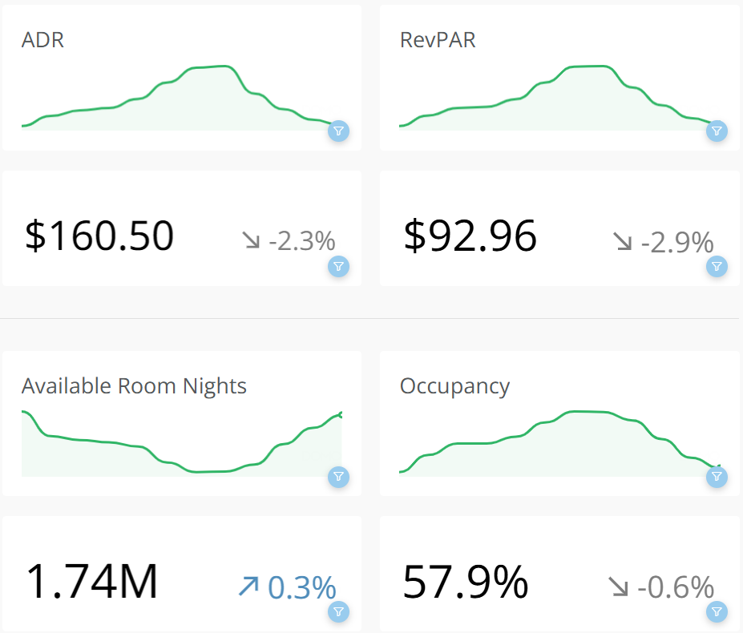
COAST REGION
YEAR TO DATE PERFORMANCE 2024 COMPARED TO 2023
SOURCE: CoStar Group

Slide 16
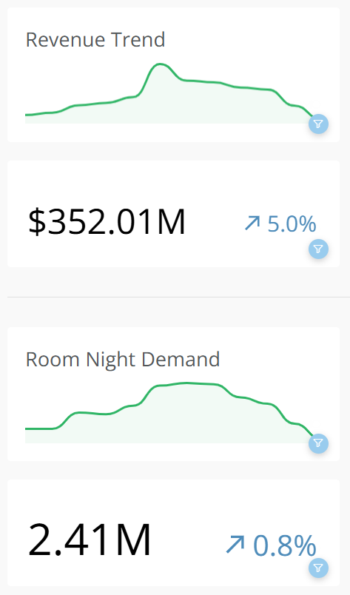
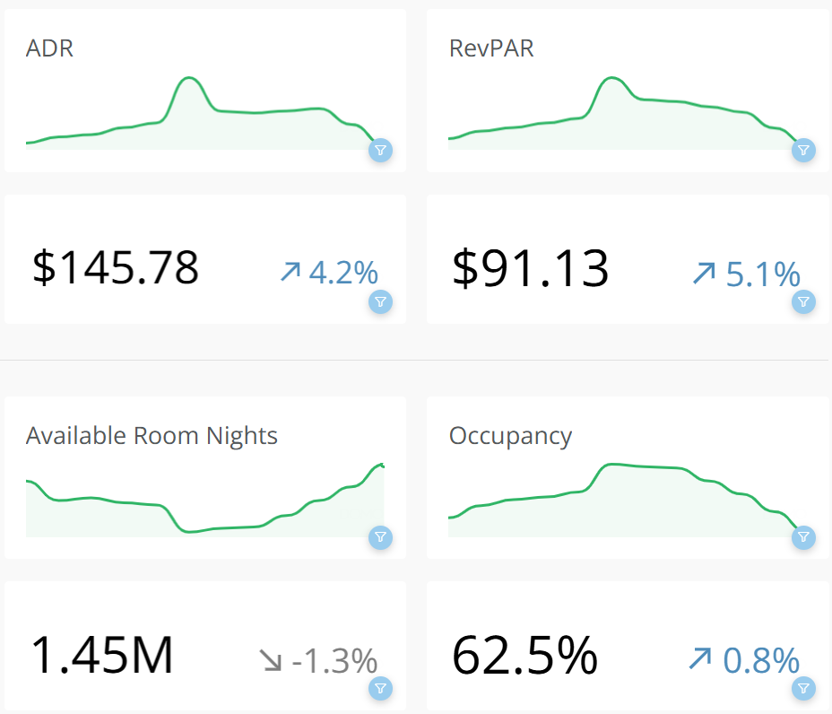
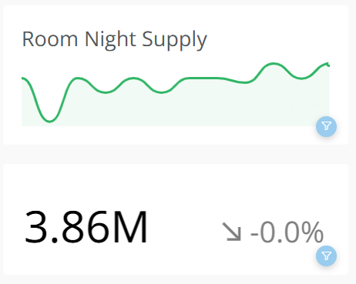
WILLAMETTE VALLEY REGION
YEAR TO DATE PERFORMANCE 2024 COMPARED TO 2023
SOURCE: CoStar Group

Slide 17
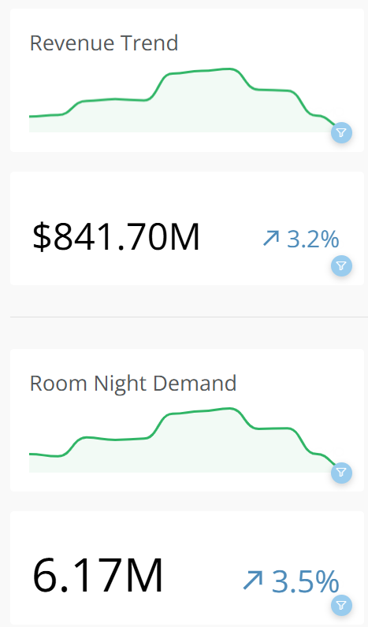
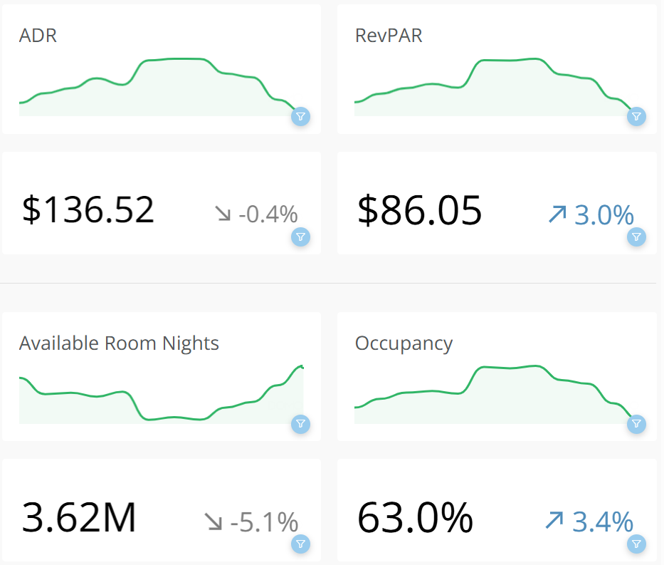
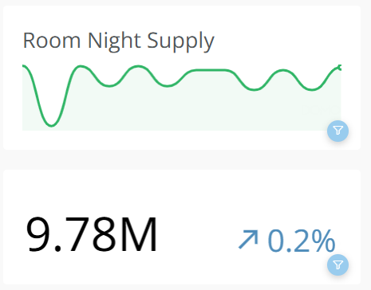
PORTLAND REGION
YEAR TO DATE PERFORMANCE 2024 COMPARED TO 2023
SOURCE: CoStar Group

Slide 18
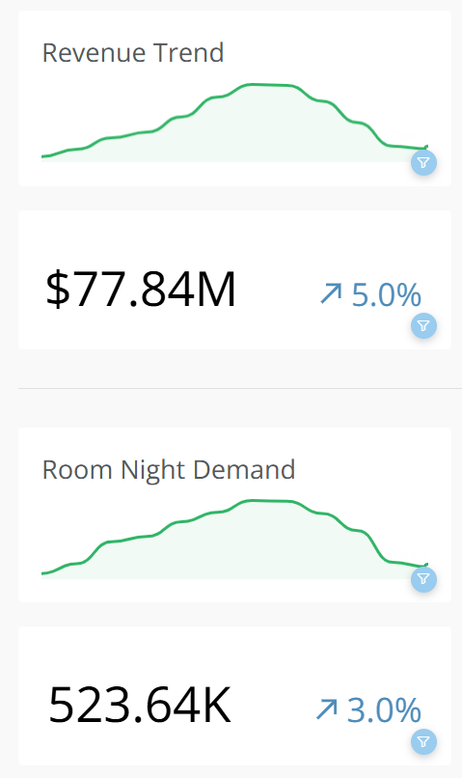
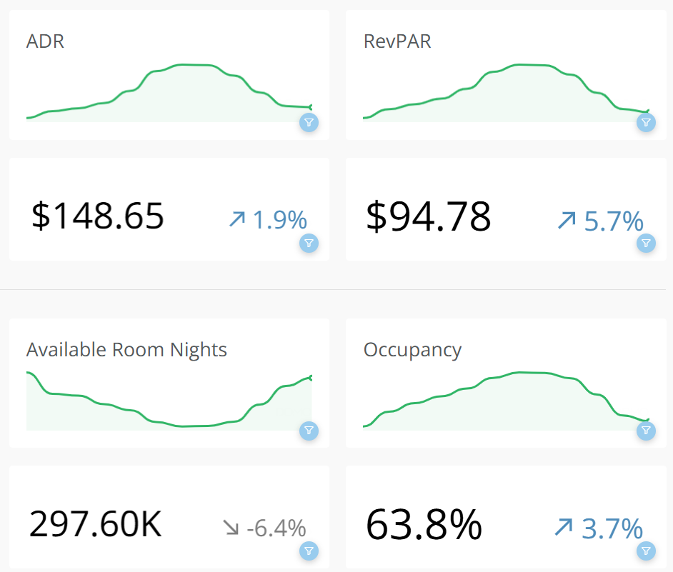
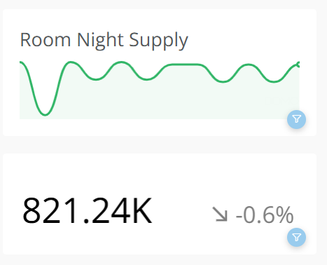
MT. HOOD & COLUMBIA RIVER GORGE
YEAR TO DATE PERFORMANCE 2024 COMPARED TO 2023
SOURCE: CoStar Group

Slide 19

SHORT TERM VACATION RENTAL (STVR)
PERFORMANCE 2024
Steens Mountain Guest Ranch, Diamond OR
Photo Courtesy of Travel Oregon

Slide 20

SHORT-TERM VACATION RENTAL PERFORMANCE
YEAR OVER YEAR(YOY)
STATEWIDE HIGHLIGHTS (ALL PROPERTY TYPES)
Occupancy in 2024 experienced zero change compared to 2023.
Room Revenue in 2024 was up 2.3% compared to 2023.
Room Supply in 2024 was up 2.0% compared to 2023.
Room Demand in 2024 was up 2.2% compared to 2023.
Revenue Per Available Room (RevPAR) was up 6.4% in 2024 compared to 2023.
Average Daily Rate in 2024 was up 6.2% compared to 2023.
Mt. Hood Hotel, Hood River OR
Photo Courtesy of Travel Oregon

Slide 21
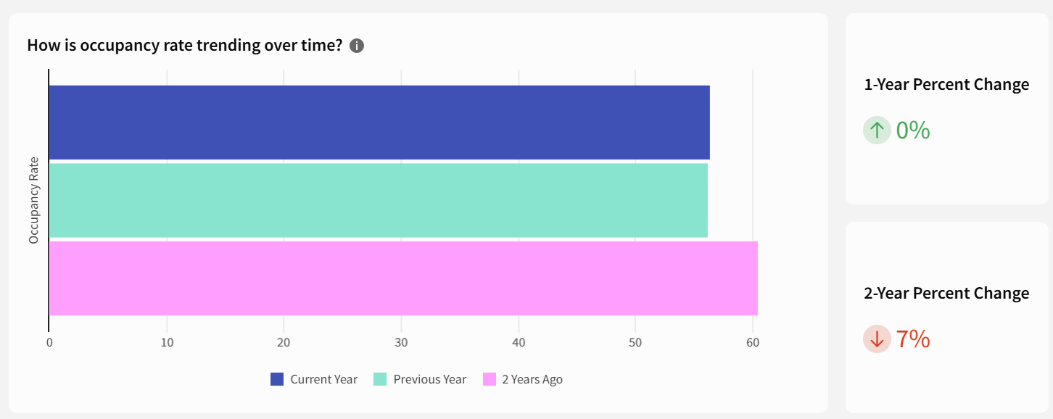
STATEWIDE OCCUPANCY
2024 AVERAGE: 56%
SOURCE: AirDNA

Slide 22
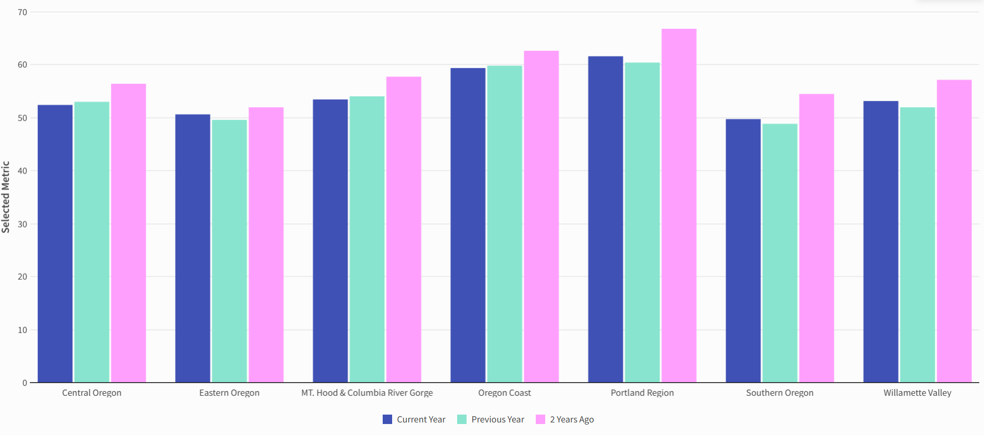
STATEWIDE OCCUPANCY BY REGION
2024 AVERAGE
SOURCE: AirDNA

Slide 23
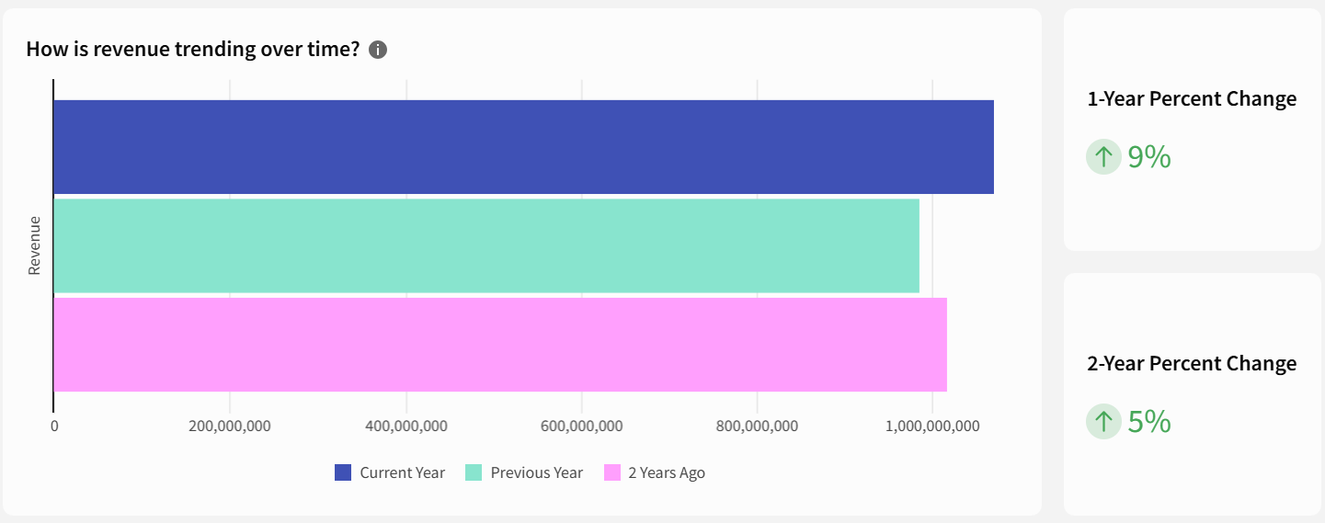
STATEWIDE REVENUE
2024 TOTAL: $1.07B
SOURCE: AirDNA

Slide 24
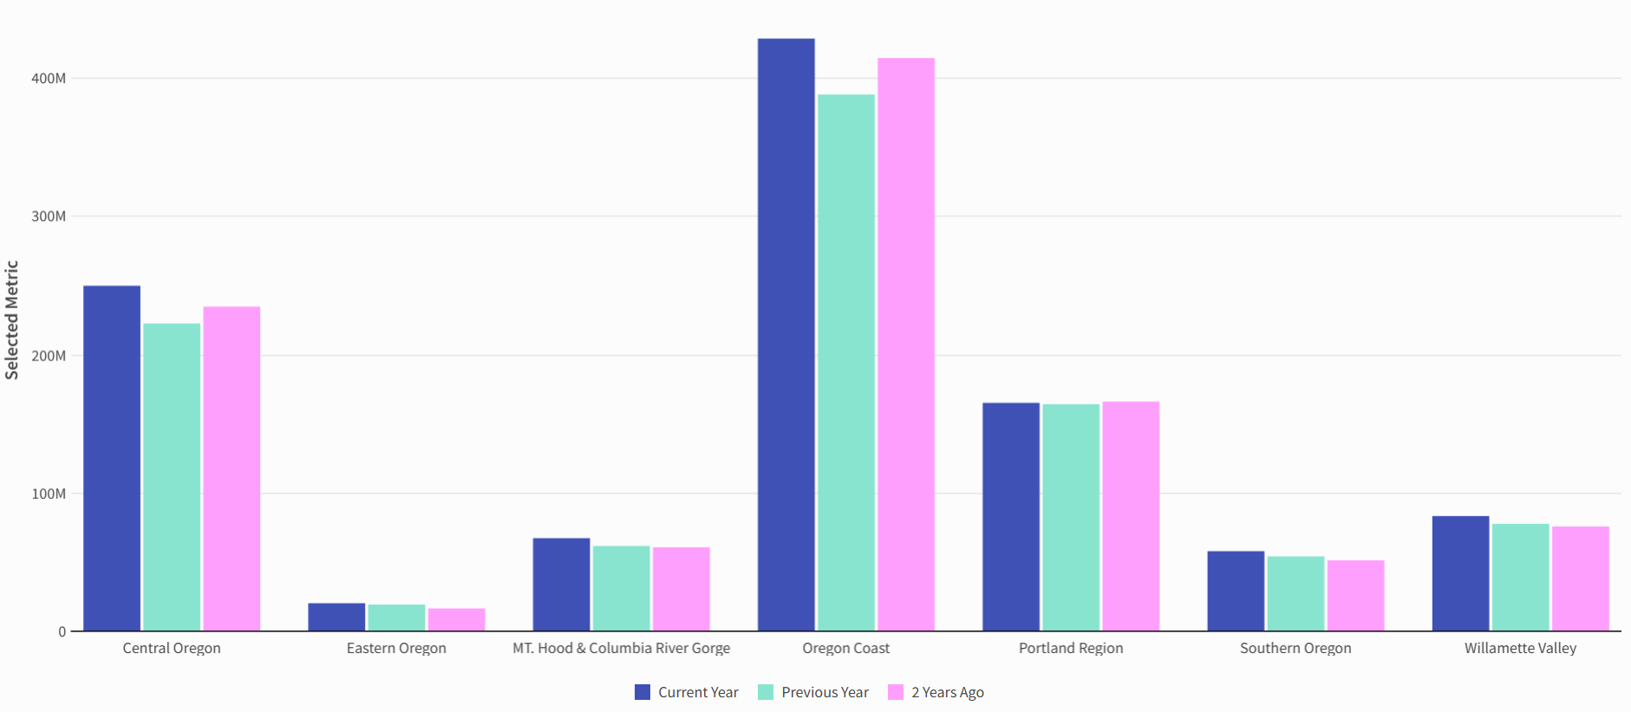
STATEWIDE REVENUE BY REGION
2024 TOTAL
SOURCE: AirDNA

Slide 25
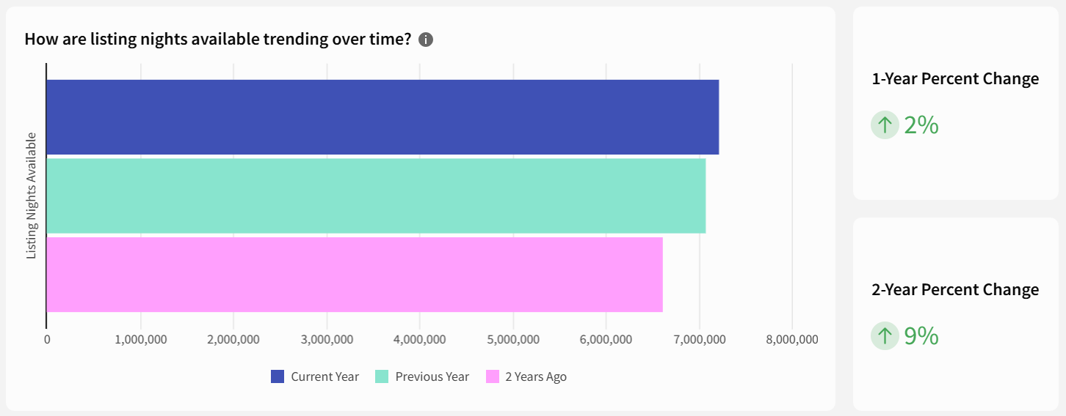
STATEWIDE ROOM SUPPLY
2024 TOTAL: 7.41M NIGHTS
SOURCE: AirDNA

Slide 26
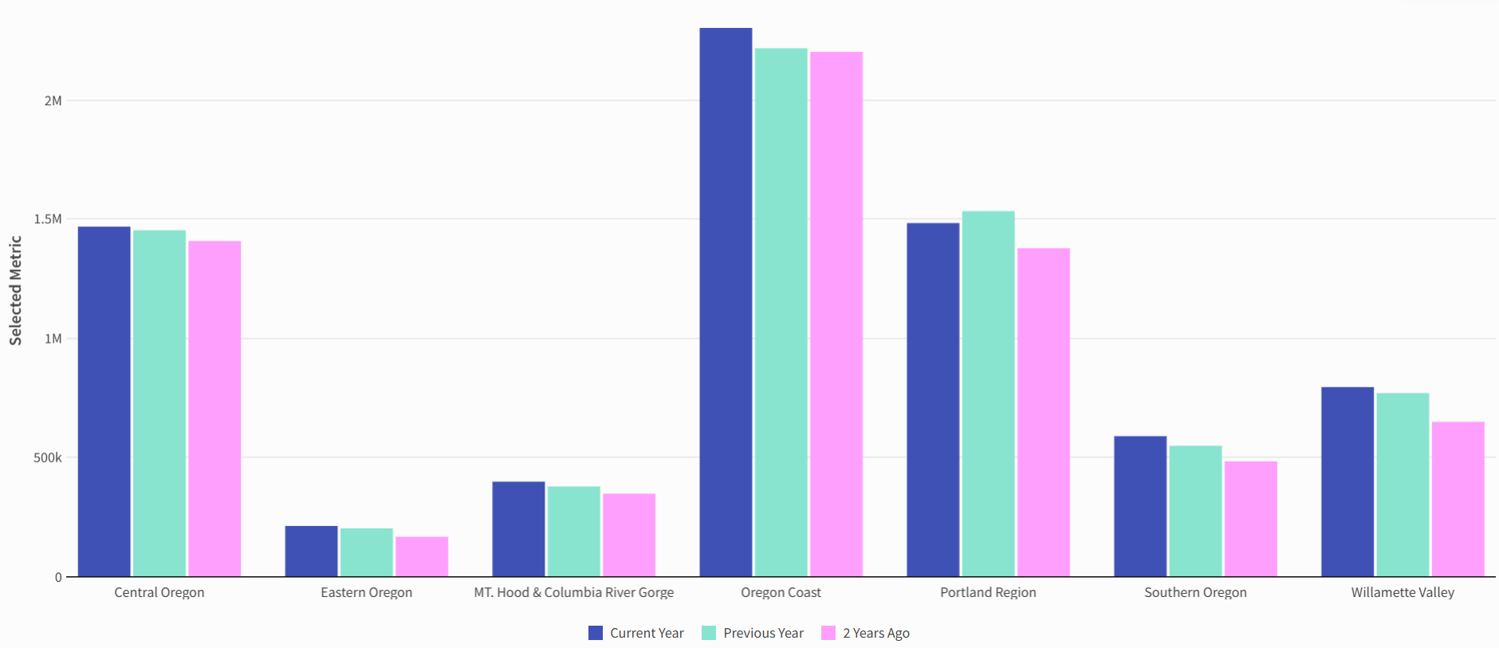
STATEWIDE ROOM SUPPLY BY REGION
2024 TOTAL
SOURCE: AirDNA

Slide 27
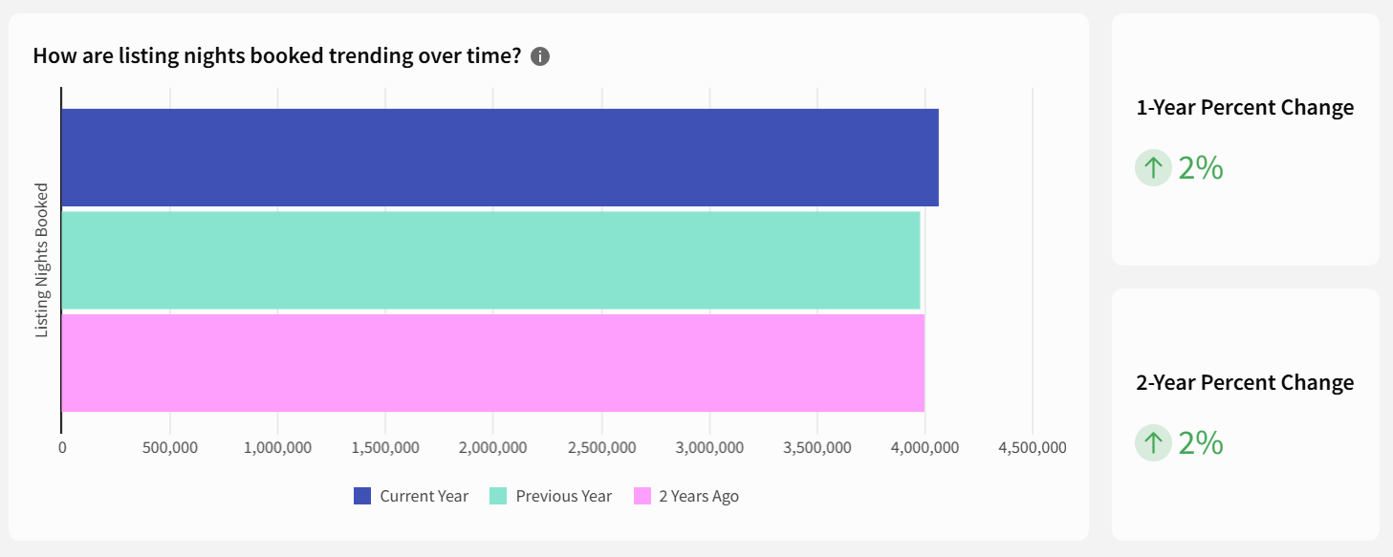
STATEWIDE ROOM DEMAND
2024 TOTAL: 4.07M NIGHTS
SOURCE: AirDNA

Slide 28
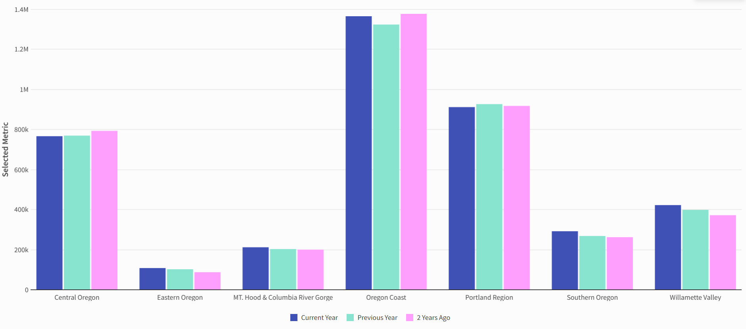
STATEWIDE ROOM DEMAND BY REGION
2024 TOTAL
SOURCE: AirDNA

Slide 29
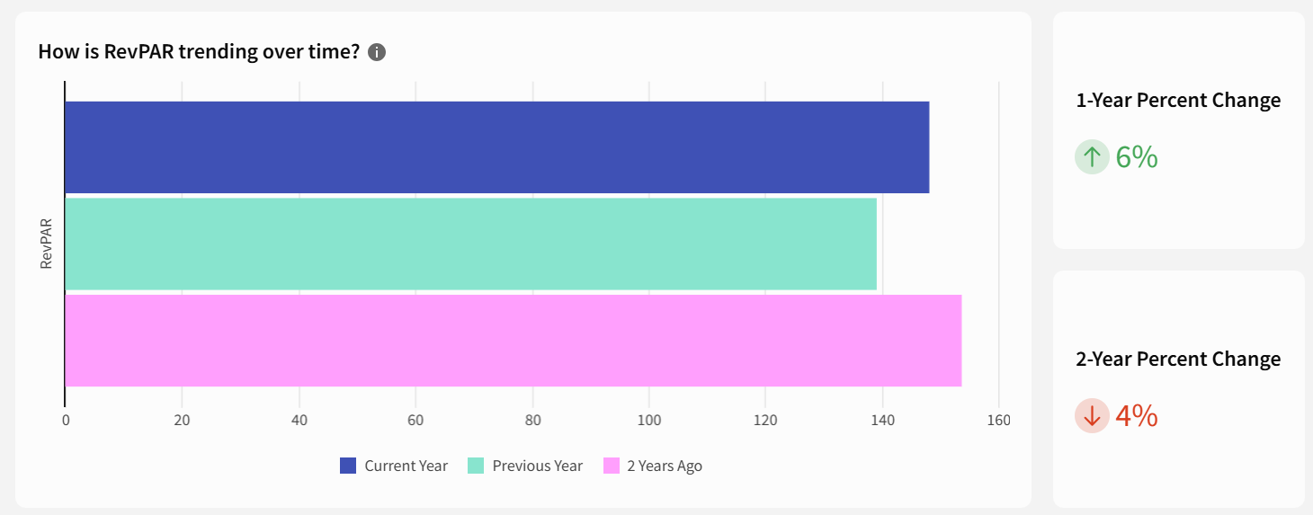
STATEWIDE REVPAR
2024 AVERAGE: $148
SOURCE: AirDNA

Slide 30
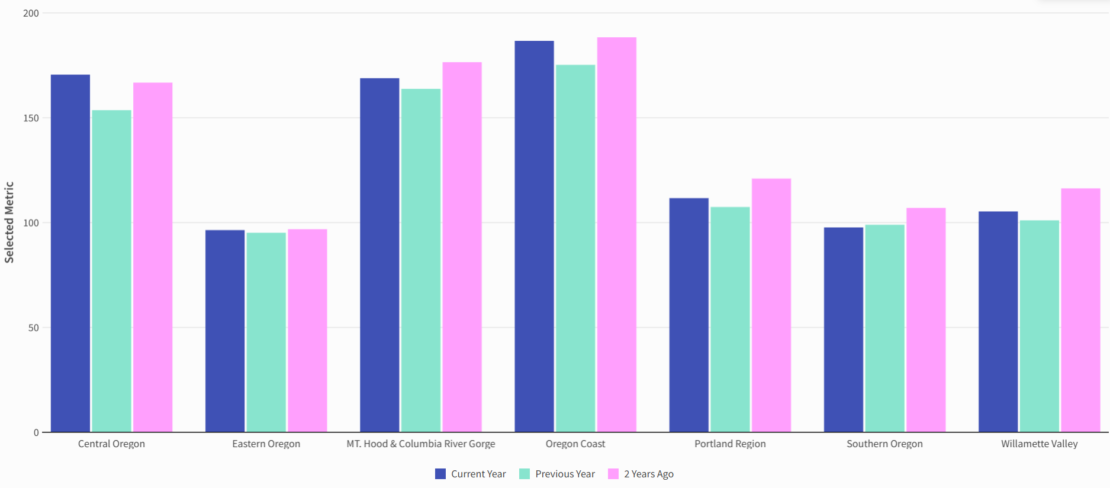
STATEWIDE REVPAR BY REGION
2024 AVERAGE
SOURCE: AirDNA

Slide 31
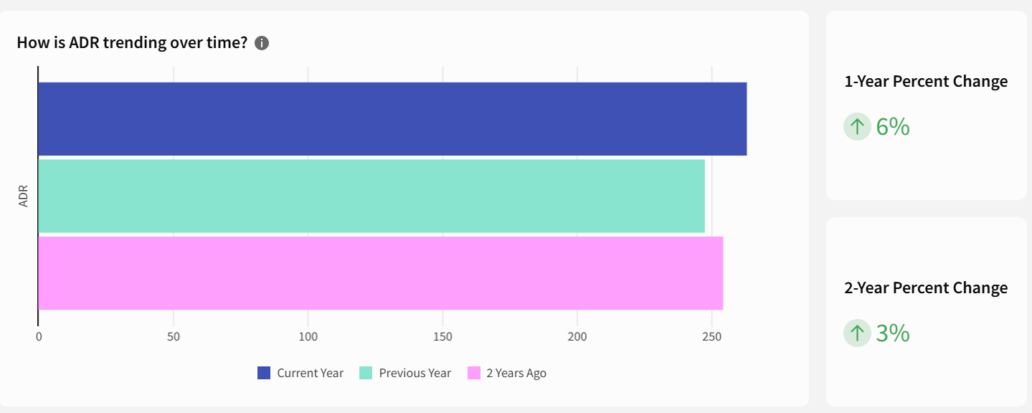
STATEWIDE ADR
2024 AVERAGE: $263 YTD
SOURCE: AirDNA

Slide 32
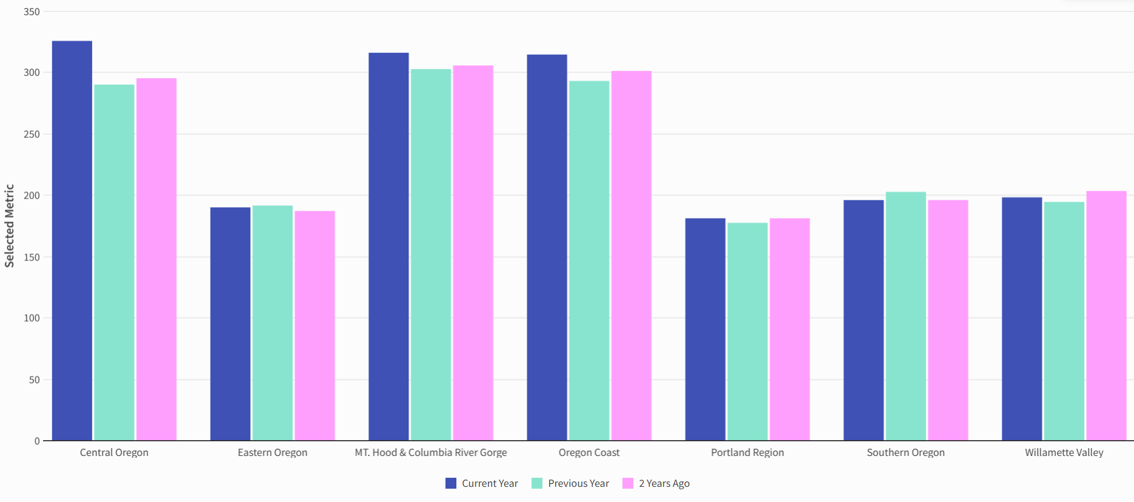
STATEWIDE ADR BY REGION
2024 AVERAGE
SOURCE: AirDNA

Slide 33
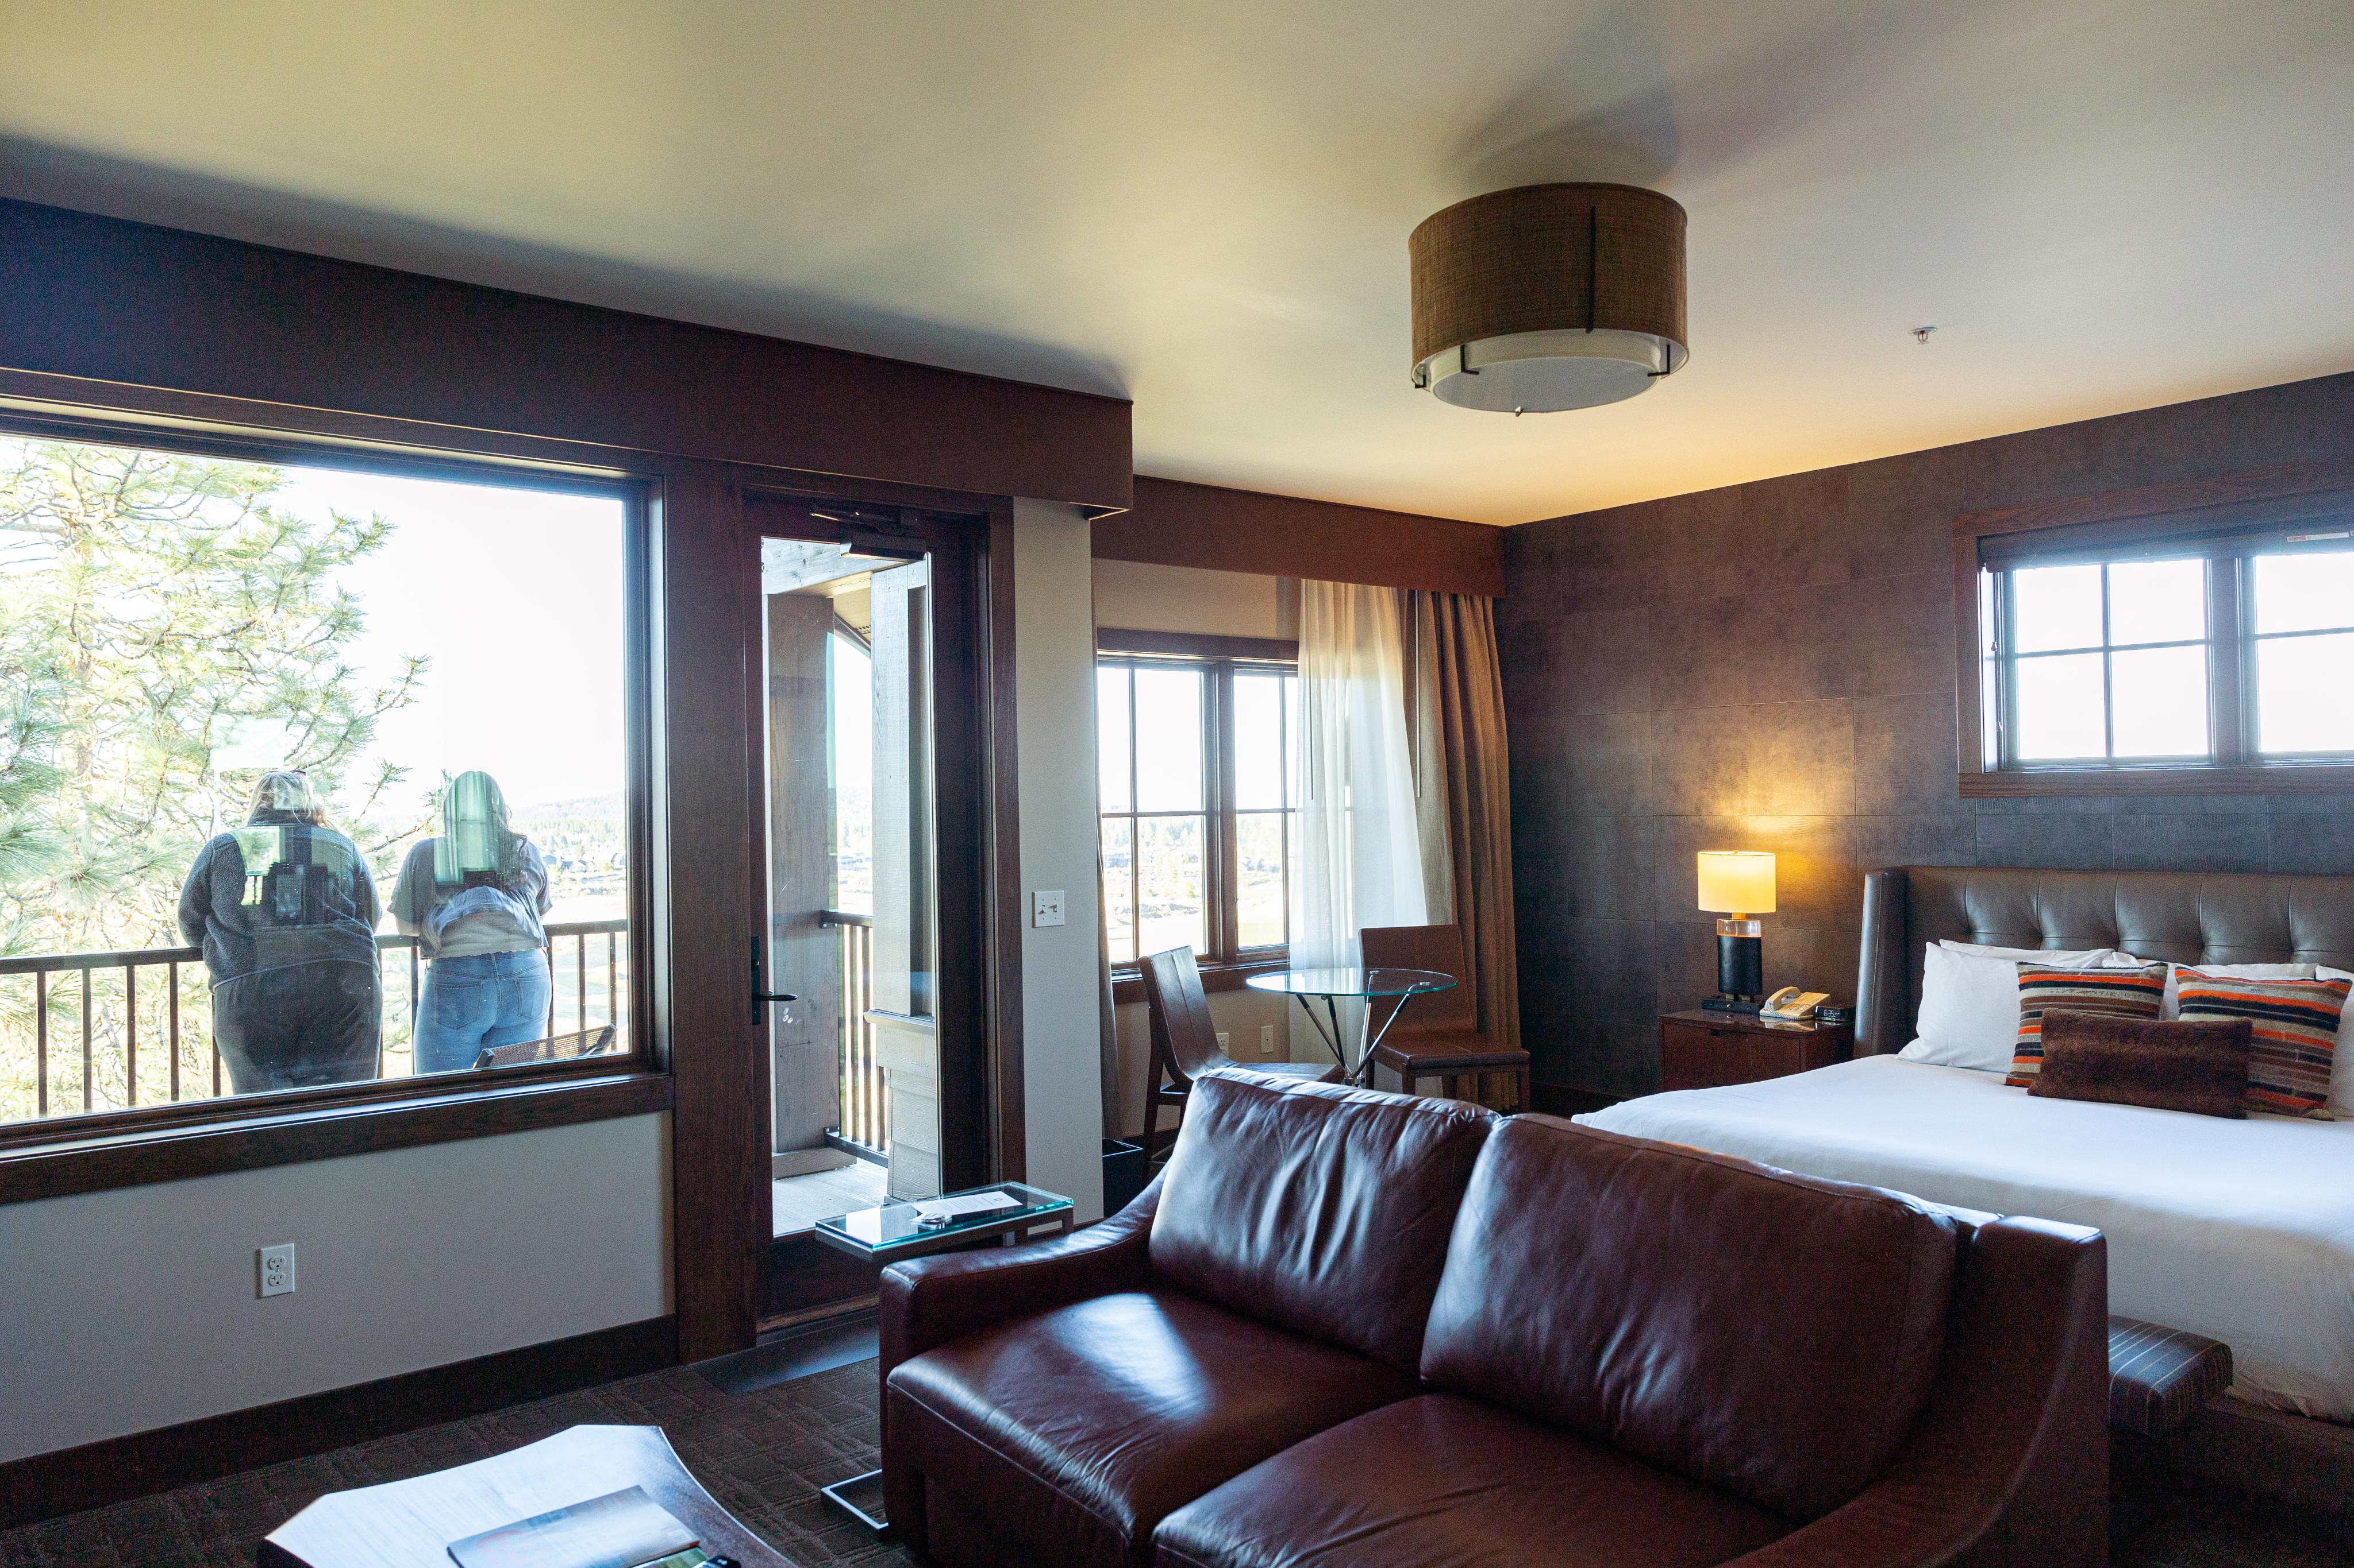
APPENDIX: POST COVID RECOVERY
Tetherow golf resort , Bend OR
Photo Courtesy of Travel Oregon

Slide 34
HOTEL

Slide 35

HOTEL PERFORMANCE
POST-COVID RECOVERY
STATEWIDE AND REGIONAL HIGHLIGHTS
Oregon continues to recover post-COVID, exceeding 2019 levels for Revenue, RevPAR, ADR, Supply and Demand.
However, statewide occupancy was down 7.6%.
6 out of 7 regions have made a full recovery in total revenue, with Portland down 10.6%.
None of the 7 regions have recovered to 2019 occupancy levels.
Balch Hotel, Dufur OR
Photo Courtesy of Michael Hanson

Slide 36
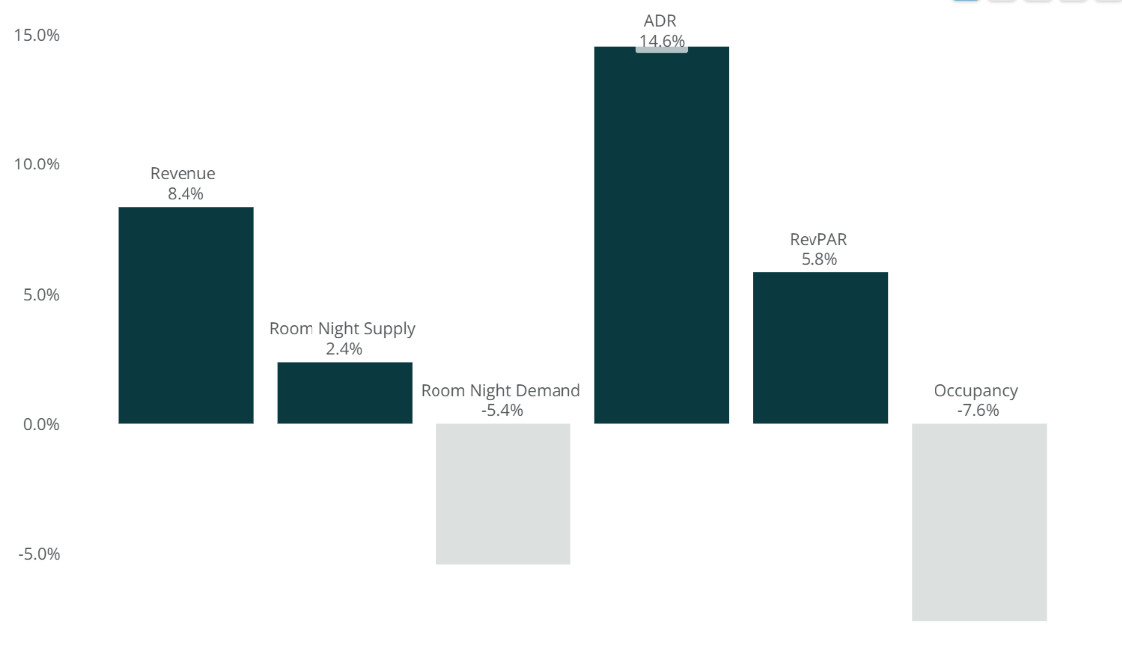
% RECOVERY FROM PRE-COVID (2019)
STATEWIDE 2024
SOURCE: CoStar Group

Slide 37
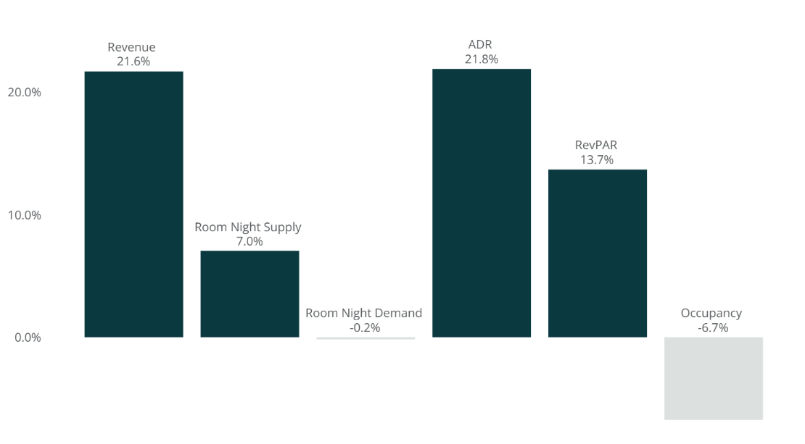
% RECOVERY FROM PRE-COVID (2019)
CENTRAL OREGON 2024
SOURCE: CoStar Group

Slide 38
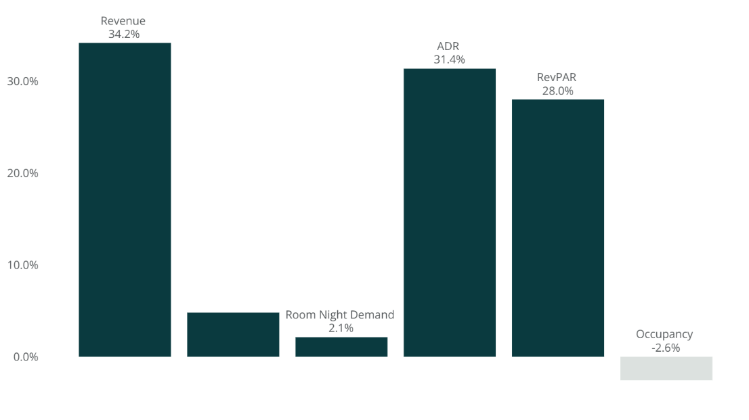
% RECOVERY FROM PRE-COVID (2019)
EASTERN OREGON 2024
Room Night Supply
4.8%
SOURCE: CoStar Group

Slide 39
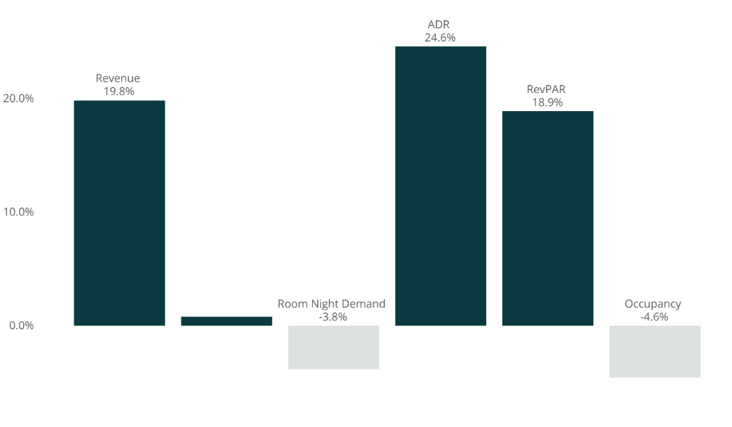
% RECOVERY FROM PRE-COVID (2019)
SOUTHERN OREGON 2024
Room Night Supply
0.8%
SOURCE: CoStar Group

Slide 40
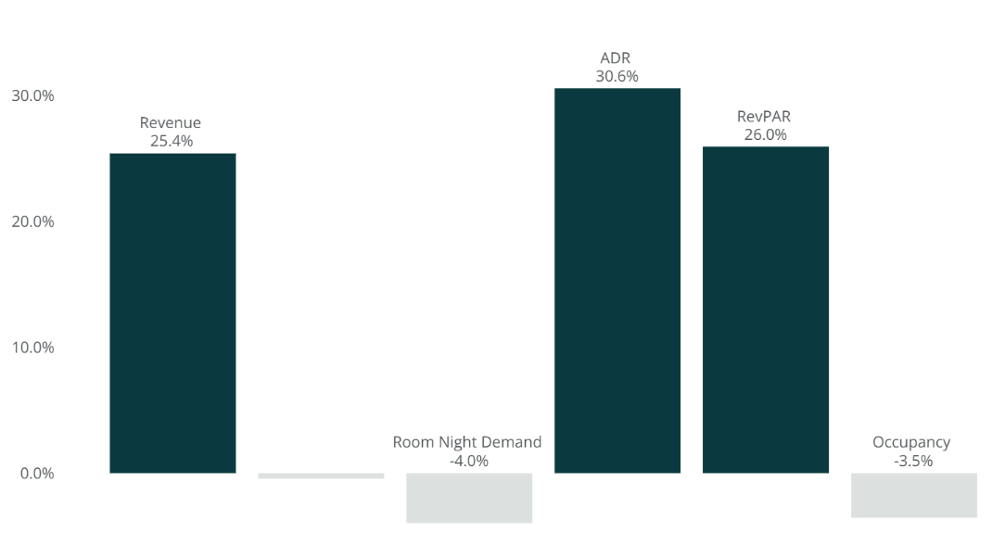
% RECOVERY FROM PRE-COVID (2019)
OREGON COAST 2024
Room Night Supply
-0.4%
SOURCE: CoStar Group

Slide 41
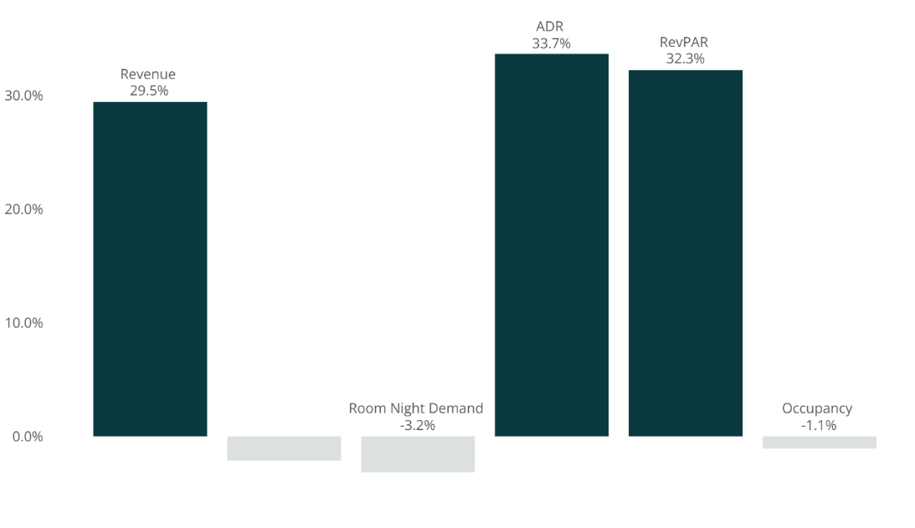
% RECOVERY FROM PRE-COVID (2019)
WILLAMETTE VALLEY 2024
Room Night Supply
-2.1%
SOURCE: CoStar Group

Slide 42
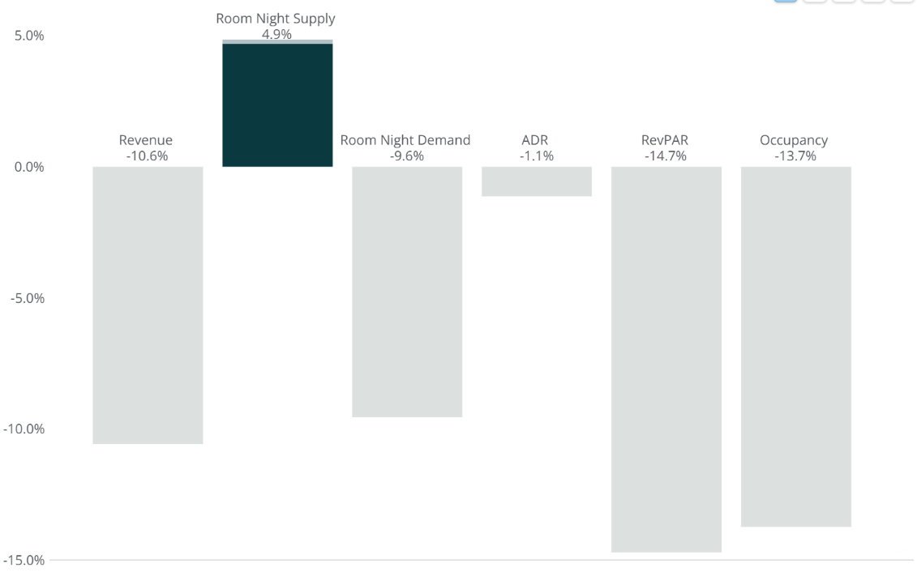
% RECOVERY FROM PRE-COVID (2019)
PORTLAND 2024
SOURCE: CoStar Group

Slide 43
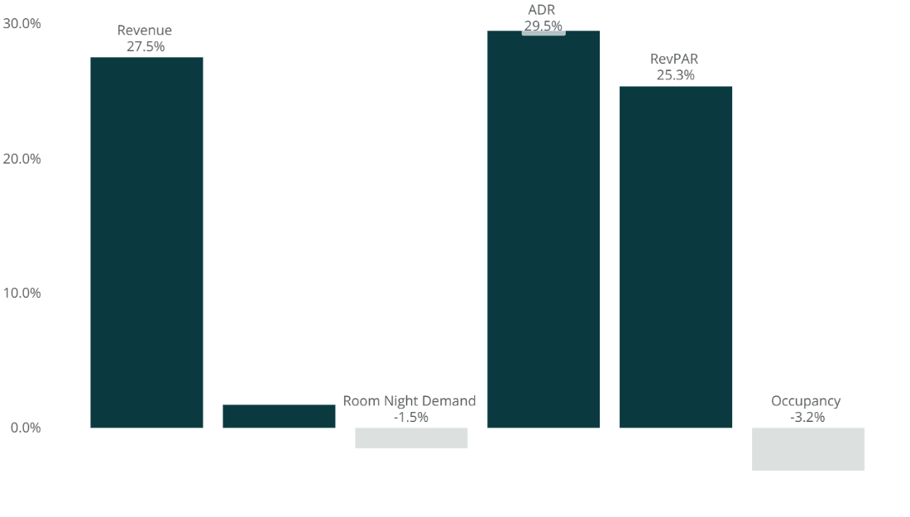
% RECOVERY FROM PRE-COVID (2019)
MT. HOOD & COLUMBIA RIVER GORGE 2024
Room Night Supply
1.7%
SOURCE: CoStar Group

Slide 44
SHORT TERM VACATION RENTAL

Slide 45

STVR PERFORMANCE
POST-COVID RECOVERY
STATEWIDE AND REGIONAL HIGHLIGHTS
In 2024, Oregon exceeded 2019 levels for all statewide metrics!
Compared to 2019, statewide occupancy was up 5.4% in 2024, and statewide revenue was up 50.7%.
Portland was the only region to not recover to pre-COVID supply and demand levels in 2024, at -20.5% and -23.4% respectively.
Portland, Southern, and Willamette Valley regions have not recovered to 2019 occupancy levels, while the other 4 regions experienced an increase. The Coast saw the largest increase at 20.7%.
River Lodge & Cabins, Boardman OR
Photo Courtesy of Travel Oregon

Slide 46
STVR PERFORMANCE
POST-COVID RECOVERY BY REGION
Percent Growth 2019→2024
SOURCE: AirDNA

Slide 47
% RECOVERY FROM PRE-COVID (2019)
CENTRAL OREGON 2024
SOURCE: AirDNA

Slide 48
% RECOVERY FROM PRE-COVID (2019)
EASTERN OREGON 2024
SOURCE: AirDNA

Slide 49
% RECOVERY FROM PRE-COVID (2019)
SOUTHERN OREGON 2024
SOURCE: AirDNA

Slide 50
% RECOVERY FROM PRE-COVID (2019)
COAST 2024
SOURCE: AirDNA

Slide 51
% RECOVERY FROM PRE-COVID (2019)
WILLAMETTE VALLEY 2024
SOURCE: AirDNA

Slide 52
% RECOVERY FROM PRE-COVID (2019)
PORTLAND 2024
SOURCE: AirDNA

Slide 53
% RECOVERY FROM PRE-COVID (2019)
MT. HOOD/CRG 2024
SOURCE: AirDNA

Slide 54

THANK YOU
Independence Hotel, Independence OR
Photo Courtesy of Joshua Rainey Photography

