Slide 1
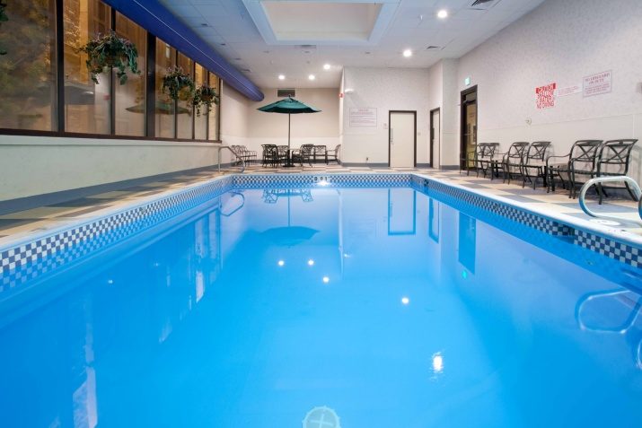

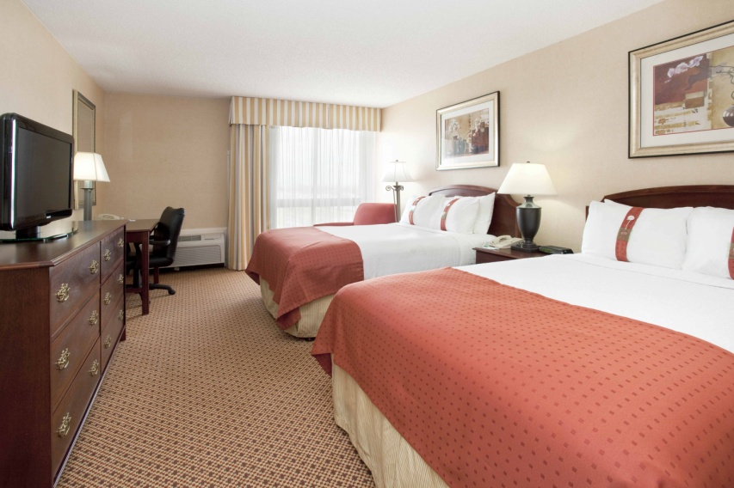
$75 Rate plus Tax
Includes Breakfast
Single or Double
*** Rate Subject to Availability ***
Early Check- In Available Upon Availability
January 17-19, 2013
307-638-4466
Ask for the LCCC Speech & Debate Tournament Rate
Rooms are limited!
For Group Reservations please call:
Katie Edmiston- Sales Manager
307-757-9112
kedmiston@cheyennehi.com
ATM
Full Service Restaurant
Lounge
Smoking & Non Smoking Rooms
Indoor Pool
Fitness Room
Guest Laundry
Business Center

